Slide 1
History
Rolf Schwarz
Notes:
History of my family and especially my grandfather

Slide 2
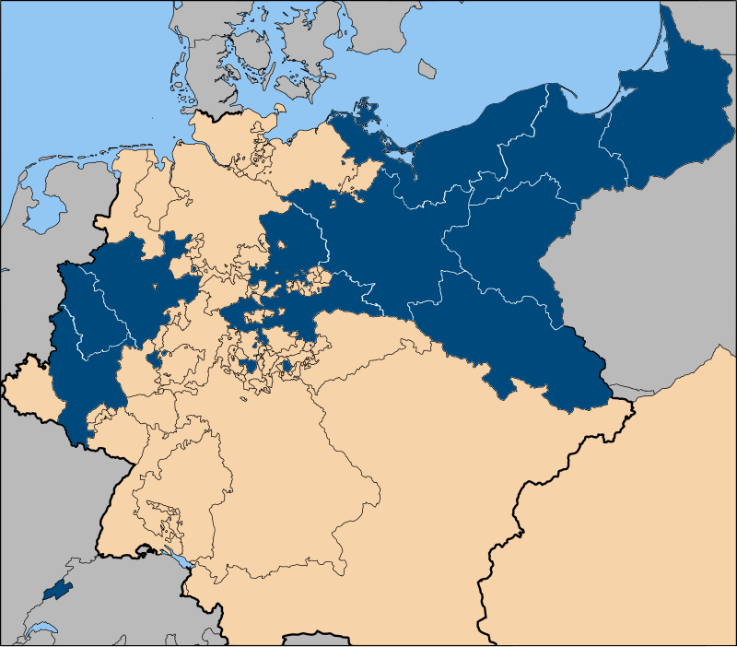
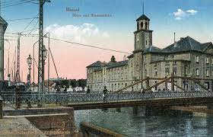
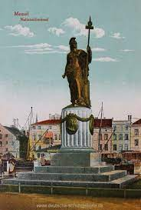
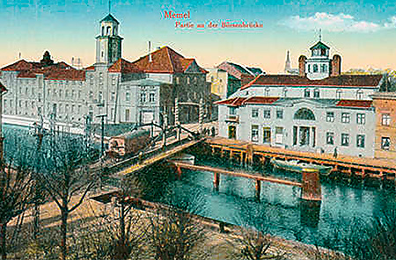
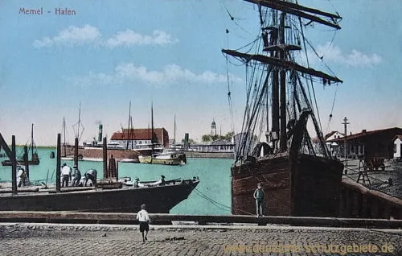
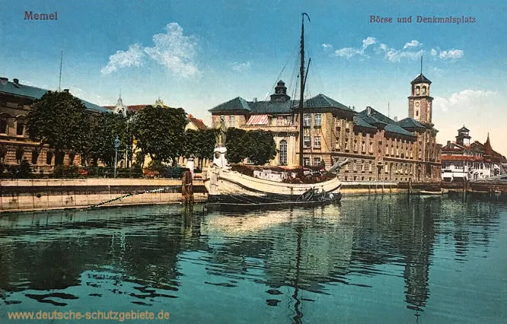
Christoph Schwarz
* Around 1800 - Memel, Ostpreußen/
Klaipeda, Lithuania
Louise Kohn
* 1805 – Memel, Ostpreußen/
Klaipeda, Lithuania
Prussia in 1815

Slide 3
Prussia = Germany?

Slide 4
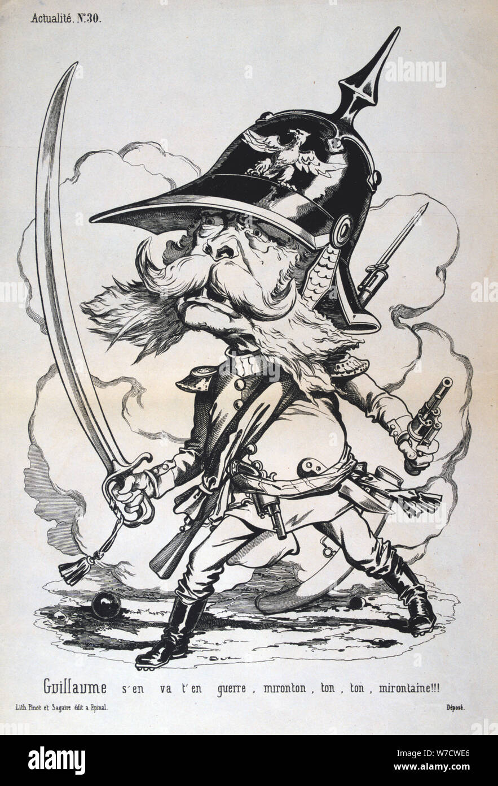
Prussia = Germany? Prussia as the quintessential Germany: Negative traits: Virtues: militaristic punctuality belligerent order blind obedience diligence strict duty no sense of humour honesty subservient frugality cold cleanliness arrogant reliability bureaucratic efficiency
Notes:
Suum cuique – „Jedem das seine“ – religious freedom

Slide 5
Prussia = Germany? Prussia as the quintessential Germany: Negative traits: Virtues: militaristic punctuality belligerent order blind obedience diligence strict duty no sense of humour honesty subservient frugality cold cleanliness arrogant reliability bureaucratic efficiency
Das Volk der Dichter und Denker
oder
Das Volk der Richter und Henker
oder gar
Das Volk der Wächter und Schlächter?

Slide 6
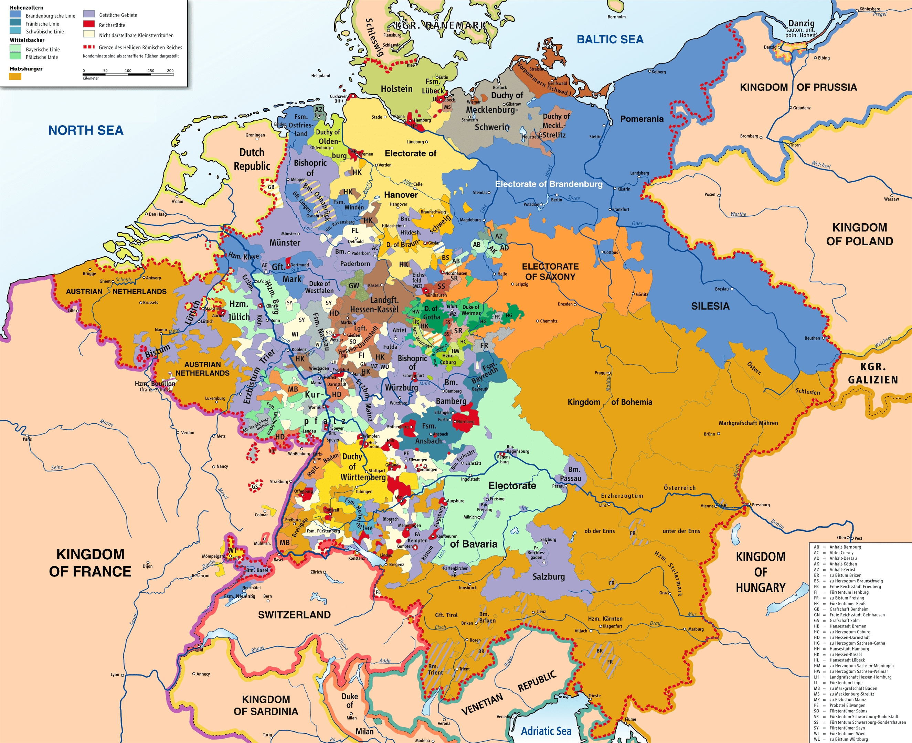
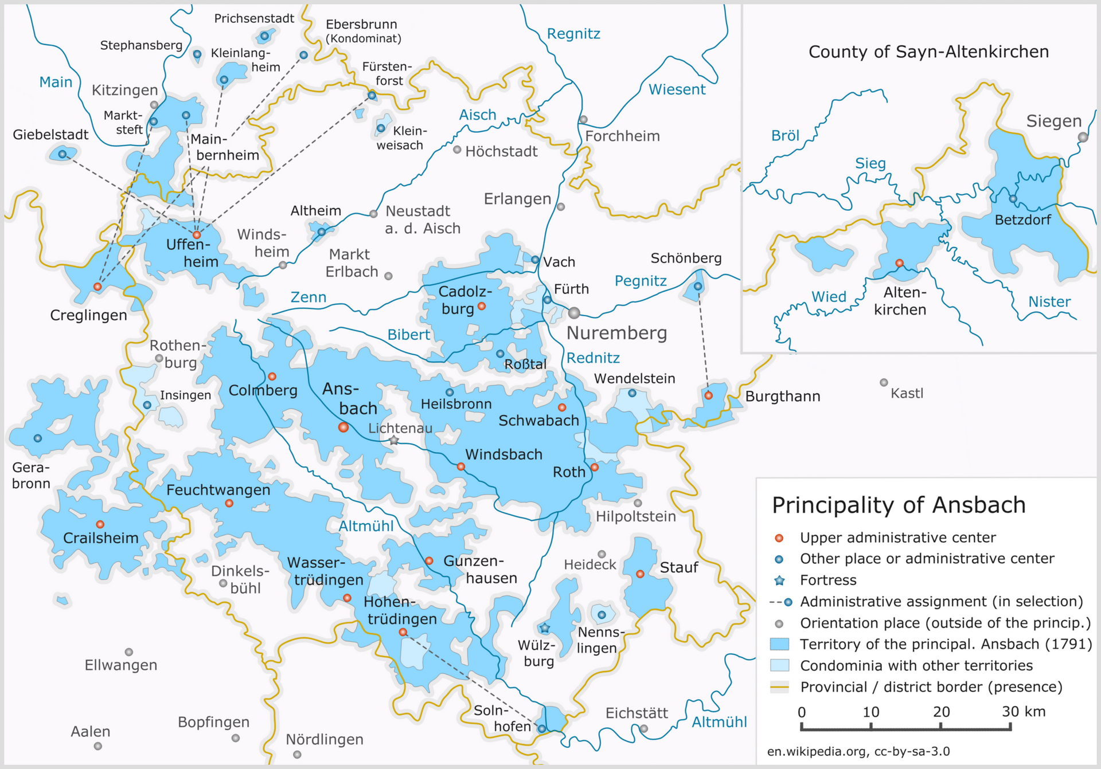
And what is Germany?
The Holy Roman Empire (of the German Nation) ( 800/1512 – 1806) was split into a great number of nearly sovereign small and medium-sized secular and ecclesiastical principalities and free imperial cities, some of which were little larger than a single town or the surrounding grounds of the monastery of an Imperial abbey.
Estimates of the total number of German states at any time during the 18th century vary, ranging from 294 to 348, most of which derived from successive dynastic splits (feudal
Map of HREoGN in 1789
fragmentation), sometimes reflected in compound names such as Saxe-Coburg; some of these were united through royal marriages, although the resulting entity was often not a contiguous territory.

Slide 7
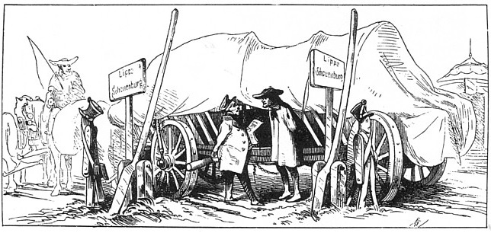
And what is Germany?
As an illustration of Germany's territorial fragmentation, young Wilhelm von Humboldt and friends, in order to observe the revolutionary events unfolding in Paris in the summer of 1789, traveled from Brunswick, capital of Brunswick-Wolfenbüttel, to the French border about 400 km away, entering and exiting six duchies, four bishoprics and one free imperial city (Aachen) before reaching the French border.
A German cartoon from 1834 poking fun at the microscopic size of the Principality of Schaumburg-Lippe, one of the many tiny states of the German Confederation.

Slide 8
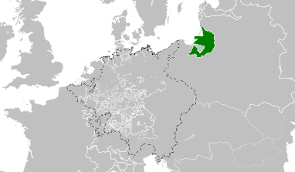
Prussia = Germany?
Herzogtum Preußen-Dutchy of Prussia - 1525
at the time of the Holy Roman Empire (of the German Nation) (after 1512)
Capital: Königsberg/Kaliningrad, Russia
Area: parts of modern Lithuania, Kaliningrad oblast (Russia), Poland

Slide 9
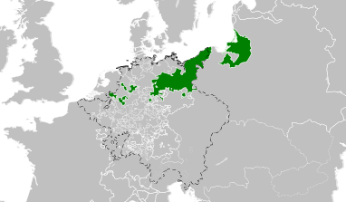
Prussia = Germany?
Königreich Preußen/Kingdom of Prussia - 1714
at the time of the Holy Roman Empire (of the German Nation) (after 1512)
Capital: Berlin
Area: parts of modern Lithuania, Kaliningrad oblast (Russia), Poland, Brandenburg (Germany)

Slide 10
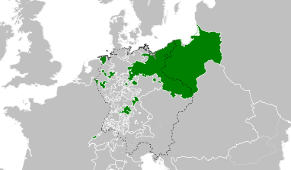
Prussia = Germany?
Königreich Preußen/Kingdom of Prussia - 1797
at the time of the Holy Roman Empire (of the German Nation) (after 1512)
Capital: Berlin
Area: parts of modern Lithuania, Latvia, Kaliningrad oblast (Russia), Pommern and Schlesien (Poland), Brandenburg (Germany)

Slide 11
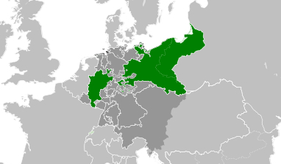
Prussia = Germany?
Königreich Preußen/Kingdom of Prussia - 1815
at the time of the German Confederation
Capital: Berlin
Area: parts of modern Lithuania, Kaliningrad oblast (Russia), Pommern and Schlesien (Poland), Brandenburg, Sachsen, Rheinland, Westphalen (Germany)

Slide 12
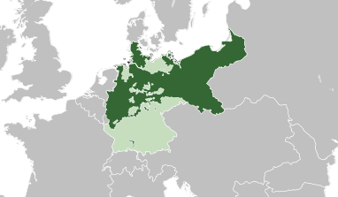
Prussia = Germany!
Königreich Preußen/Kingdom of Prussia – 1870-1914
at the time of the Norddeutscher Bund/German Confederation from 1866 and the Deutsches Reich/German Empire (after 1871)
Capital: Berlin
Area: parts of modern Lithuania, Kaliningrad oblast (Russia), Pommern and Schlesien (Poland), Brandenburg, Sachsen, Rheinland, Westphalen, Hannover, Niedersachsen, Hessen, Schleswig Holstein (Germany)

Slide 13
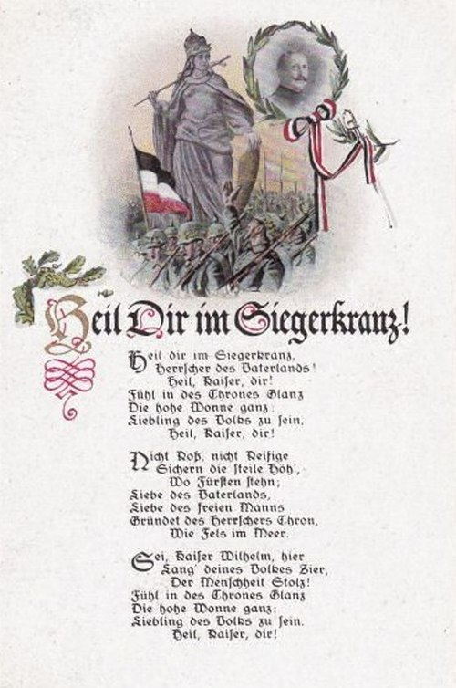

Prussia = Germany

Slide 14
Prussia = Germany!
“Heil dir im Siegerkranz" (German for "Hail to Thee in the Victor's Crown", literally: "Hail to Thee in the Victor's Wreath") was the royal anthem of Prussia since 1795.
As Prussia was the largest state of the German Empire and the Prussian king became the German emperor, it became the official national anthem of the German Empire from 1871 to 1918.

Slide 15
Christoph Schwarz
* Around 1800 - Memel, Ostpreußen/
Klaipeda, Lithuania
Louise Kohn
* 1805 – Memel, Ostpreußen/
Klaipeda, Lithuania
Prussia in 1815

Slide 16
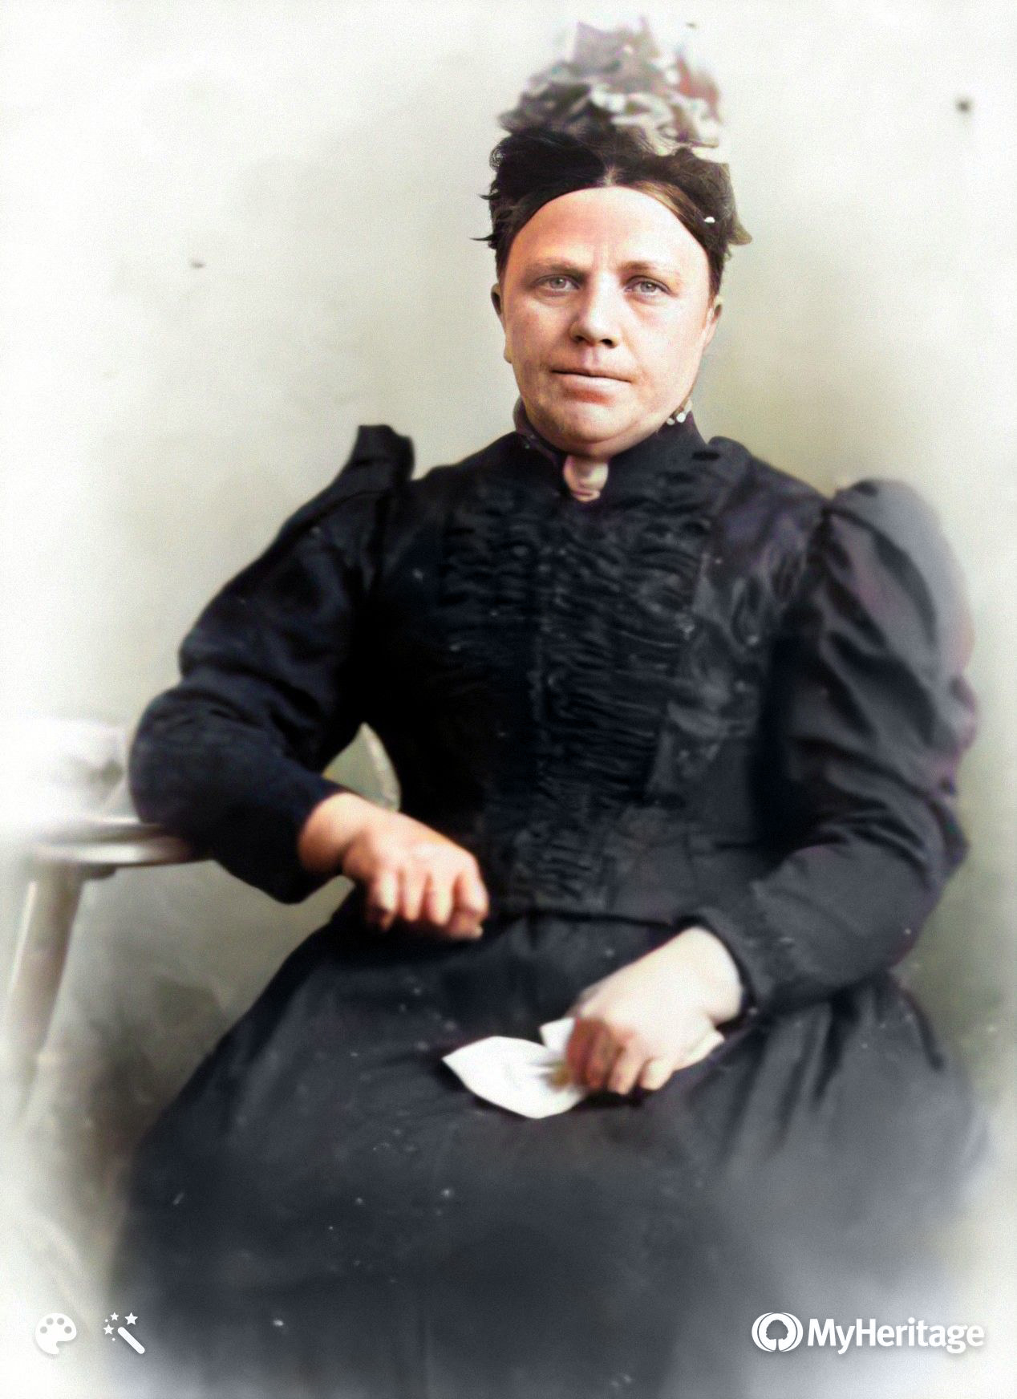
Dorothea Nawiinski/Navjinski
Friedrich August Schwarz
* 1825 - Salzhof, Westpreußen/Wapno, Poland
✝ 1872 - Marienburg, Westpreußen/Malborg, Poland
* 1836 - Bruch,Ostpreußen/Bruk, Poland
✝ 1912 - Elbing, Westpreußen/Elblag, Poland
Mother:
Regina Nawiinski/Navjinski
* 1807 - Bruch, Ostpreußen/ Bruk, Poland
Parents:
Adam Nawiinski/Navjinski + Anna Marie Kruse
* around 1780

Slide 17
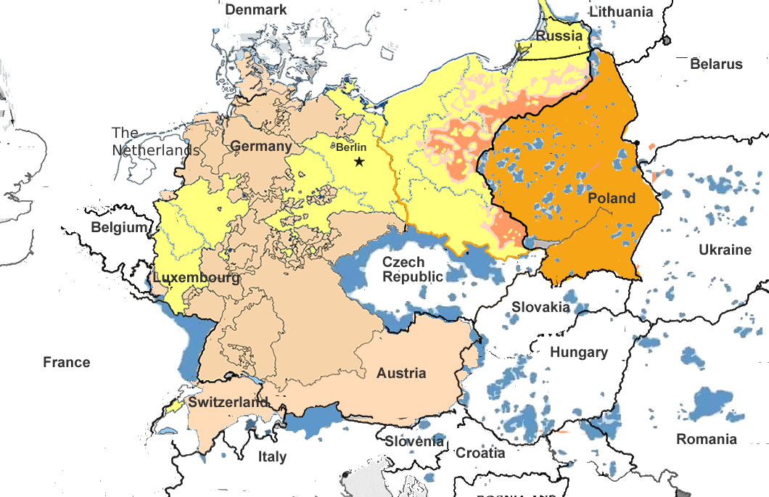
Prussia 1815
Notes:
Prussian = Polish ≠ German; Prague defenestration 1618: religious – nationalist - local

Slide 18
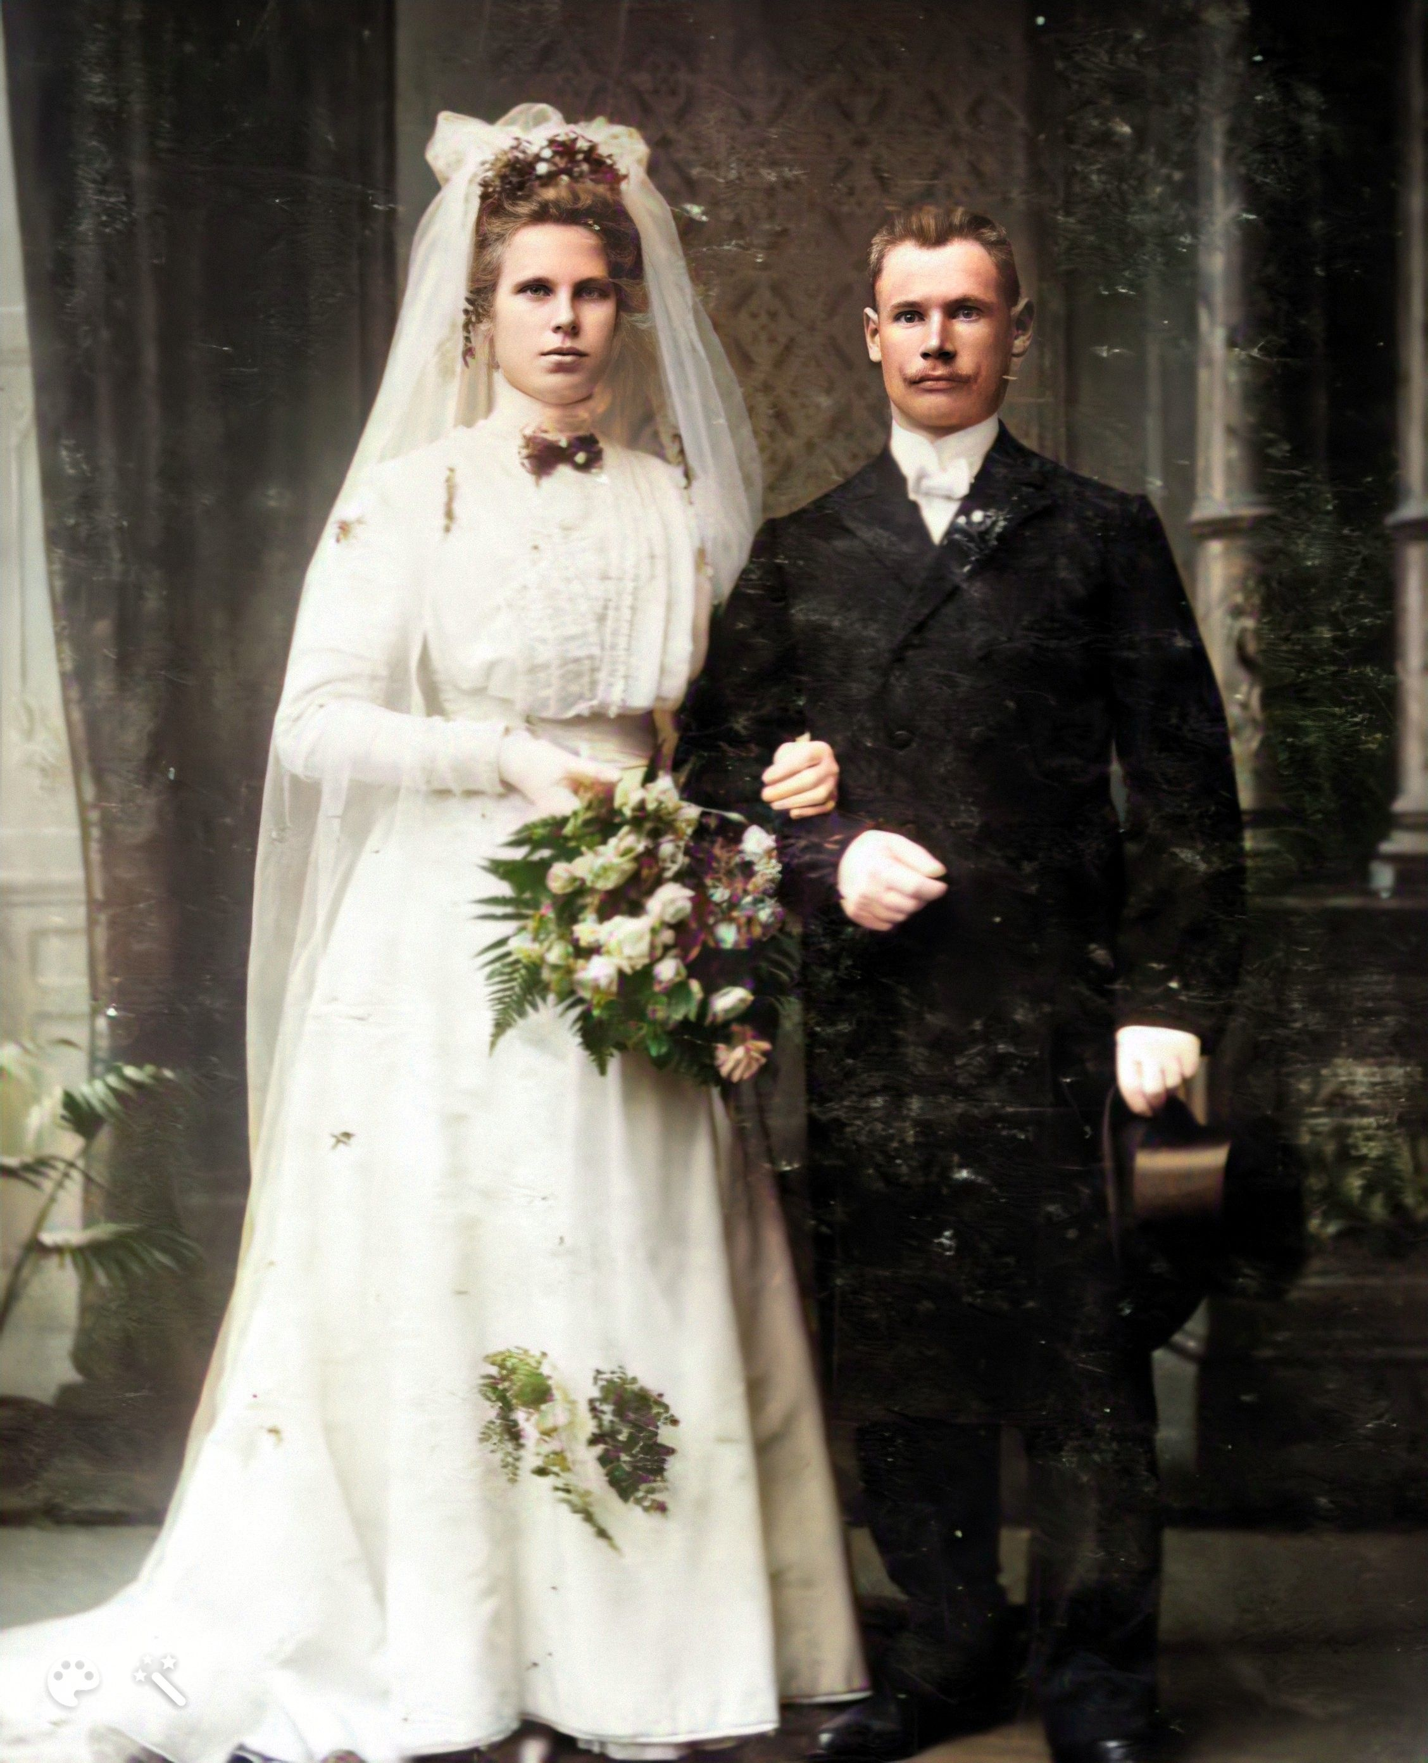
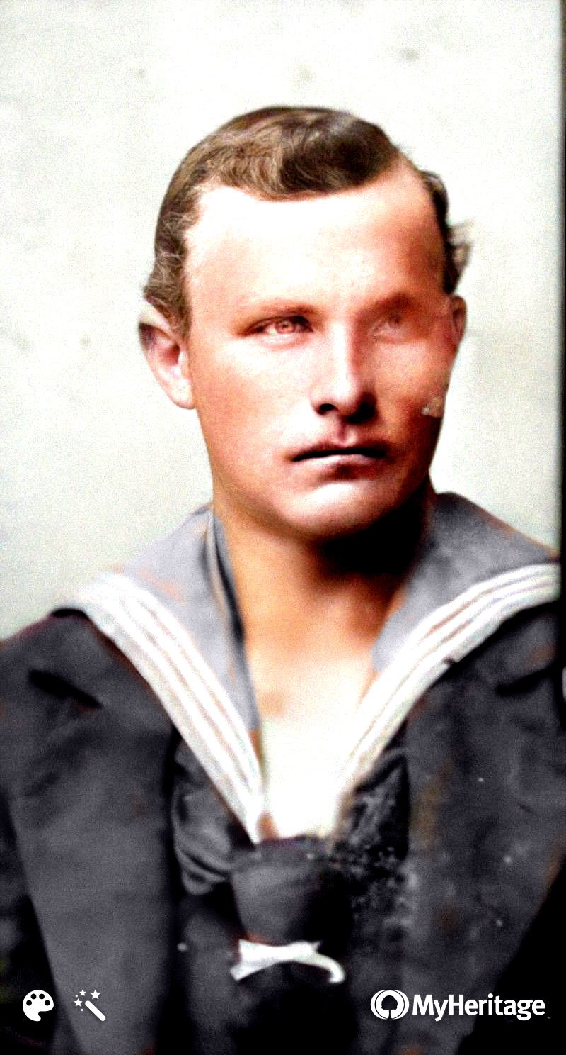
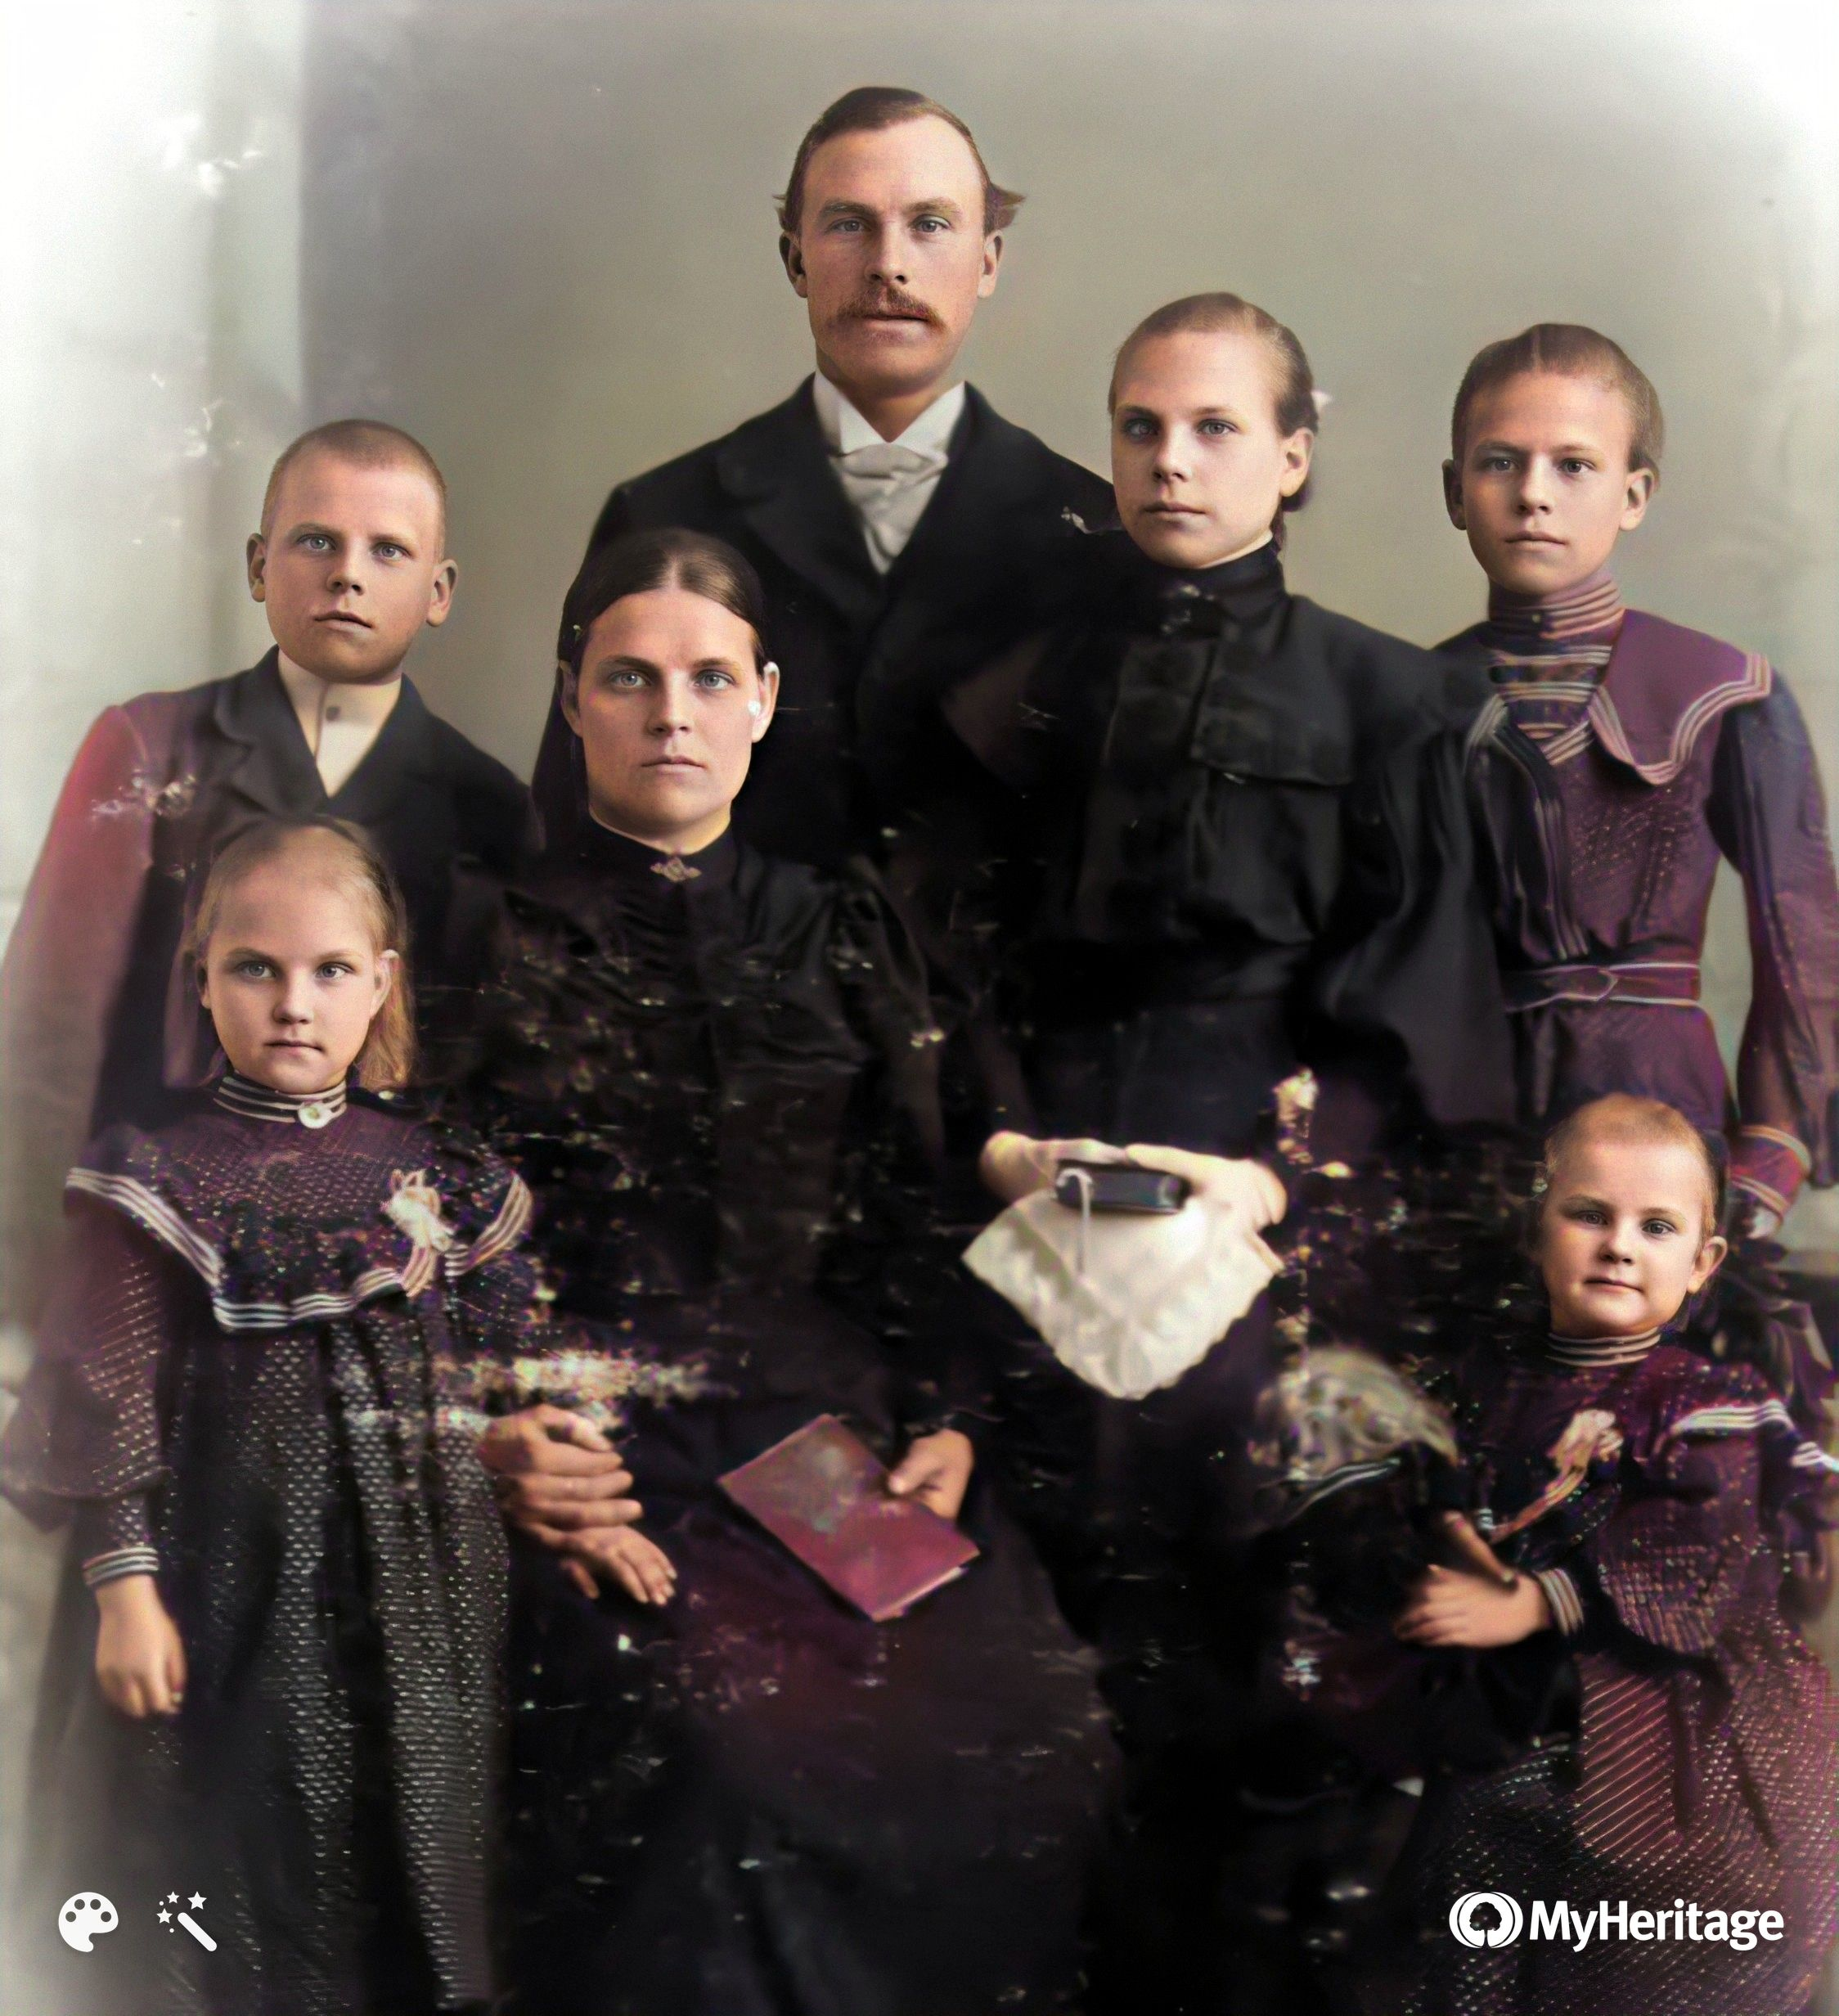
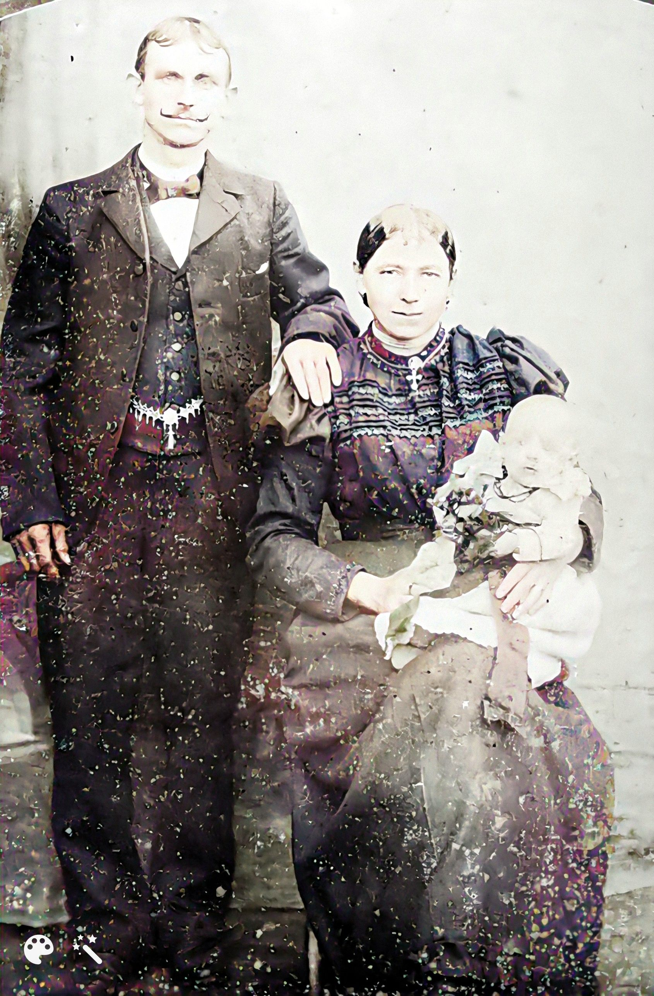
The four sons of Friedrich August and Dorothea
Paul August
1865 - 1945
Carl Friedrich
1867 - 1952
Wilhelm
Ferdinand
All sons were born in Marienburg, Westpreußen/Malborg, Poland.
Paul married Marianne Polzin, from Schetzingen,Westpreußen/ Wszedien,Poland, who did not speak German, in 1897. The couple moved to Seehausen in Saxony-Anhalt, Germany, shortly after the wedding; the wedding was in May, and in August of the same year, their first child, Hedwig, was born in Seehausen.

Slide 19
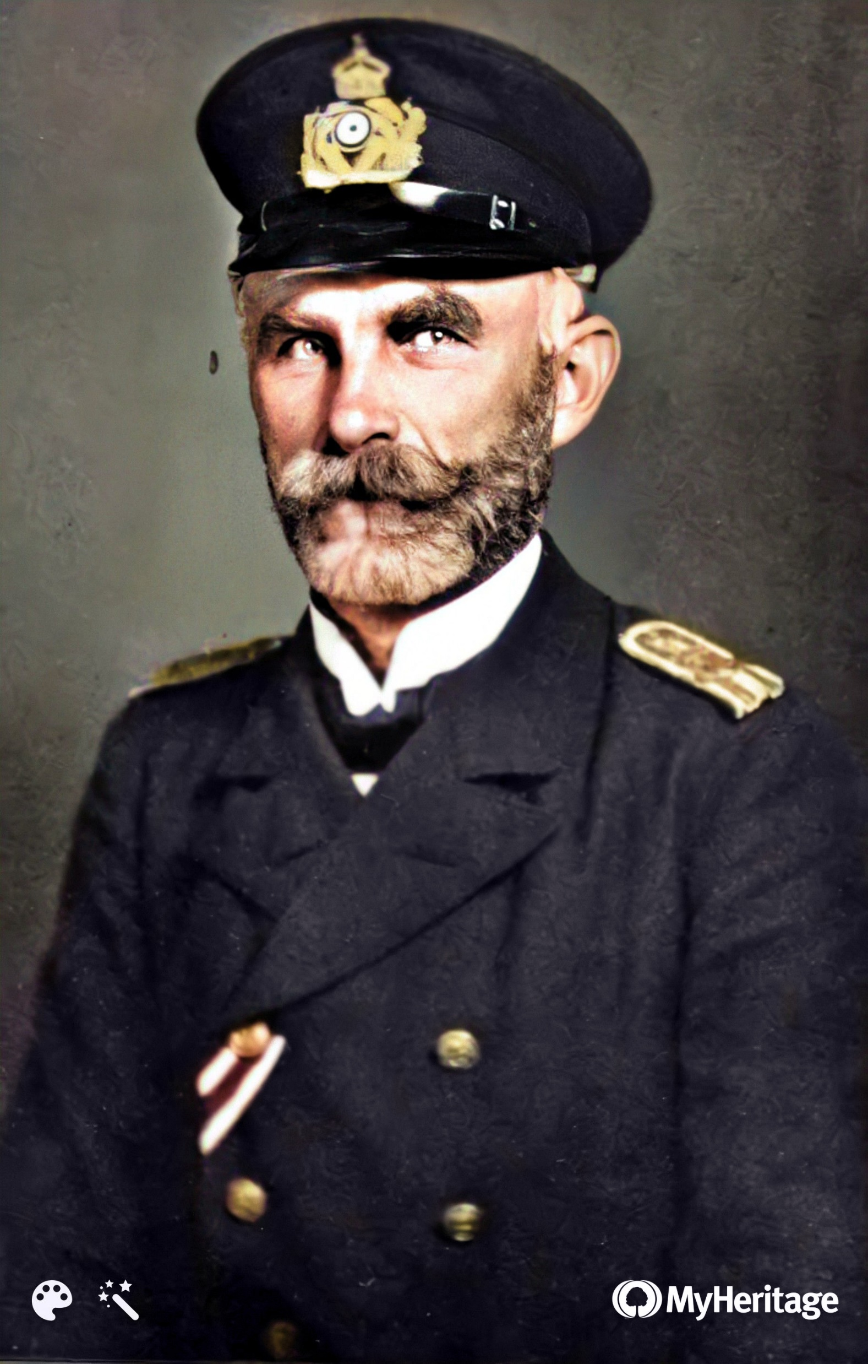
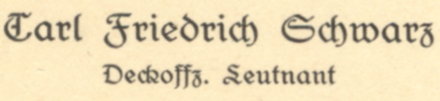
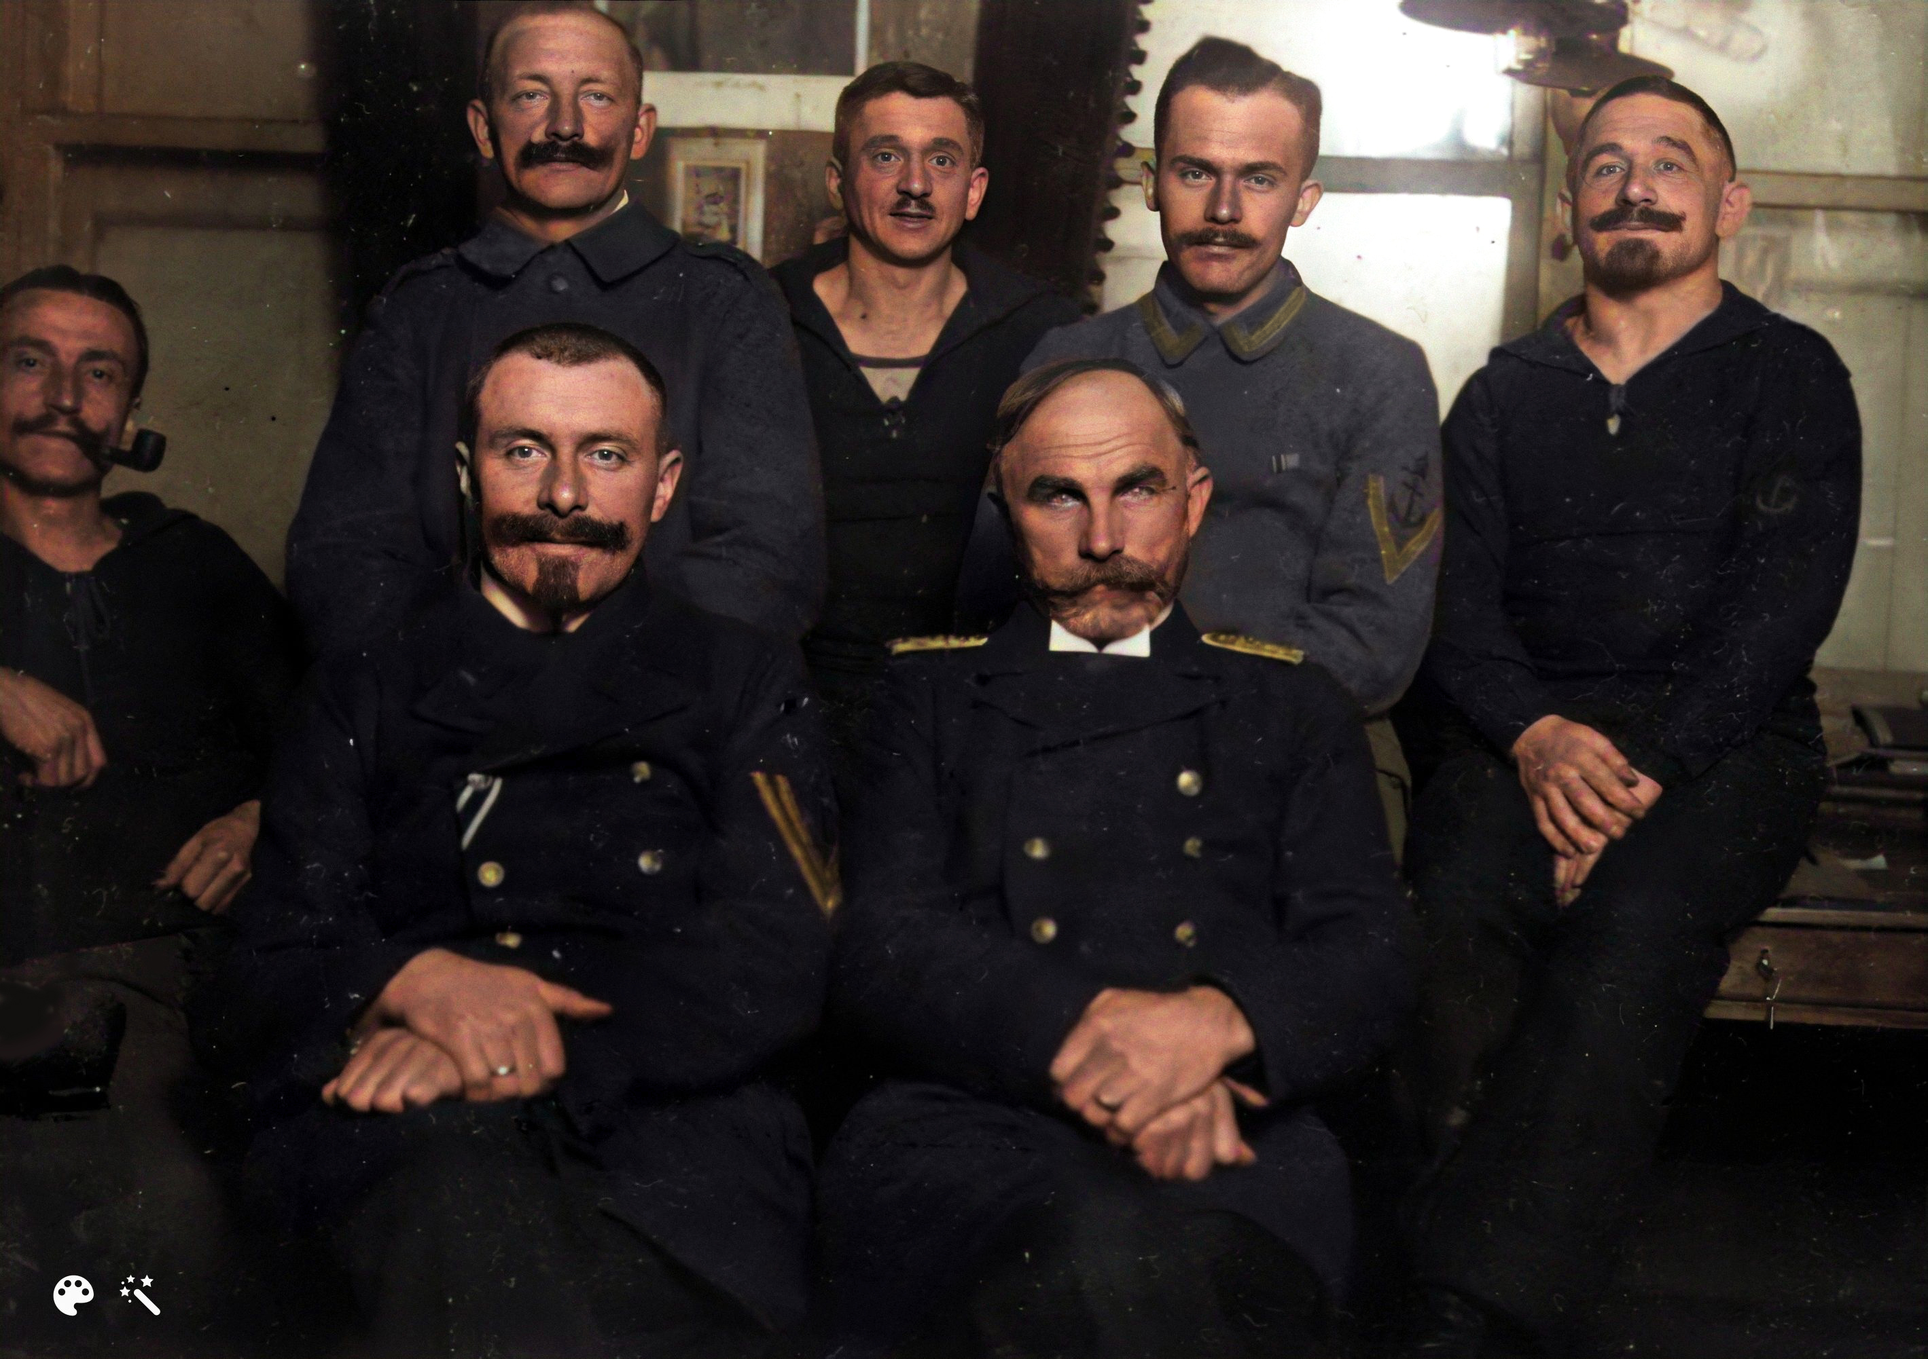
My great-grandfather
* 1867 – Marienburg, Westpeußen/
Malborg, Poland ✝ 1952 - Lingen/Germany
Notes:
hohes Sozialprestige. Das preußische Offizierkorps, in seinen höheren Rängen noch ganz überwiegend adlig, galt als staatstragende Elite. Berufliche Aufstiegschancen hatten meist nur die Bürger, die zuvor in der Armee gedient hatten. Die Offiziere der Armee stammten fast ausschließlich aus dem landbesitzenden Adel.

Slide 20
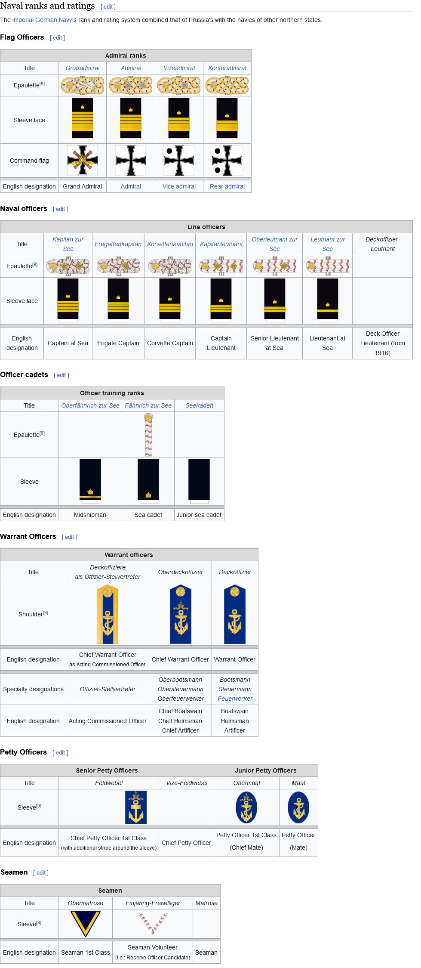
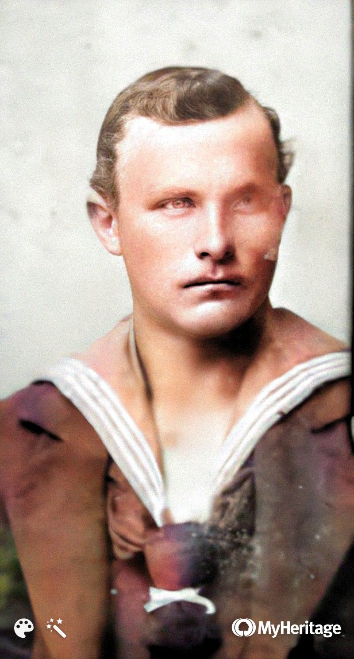
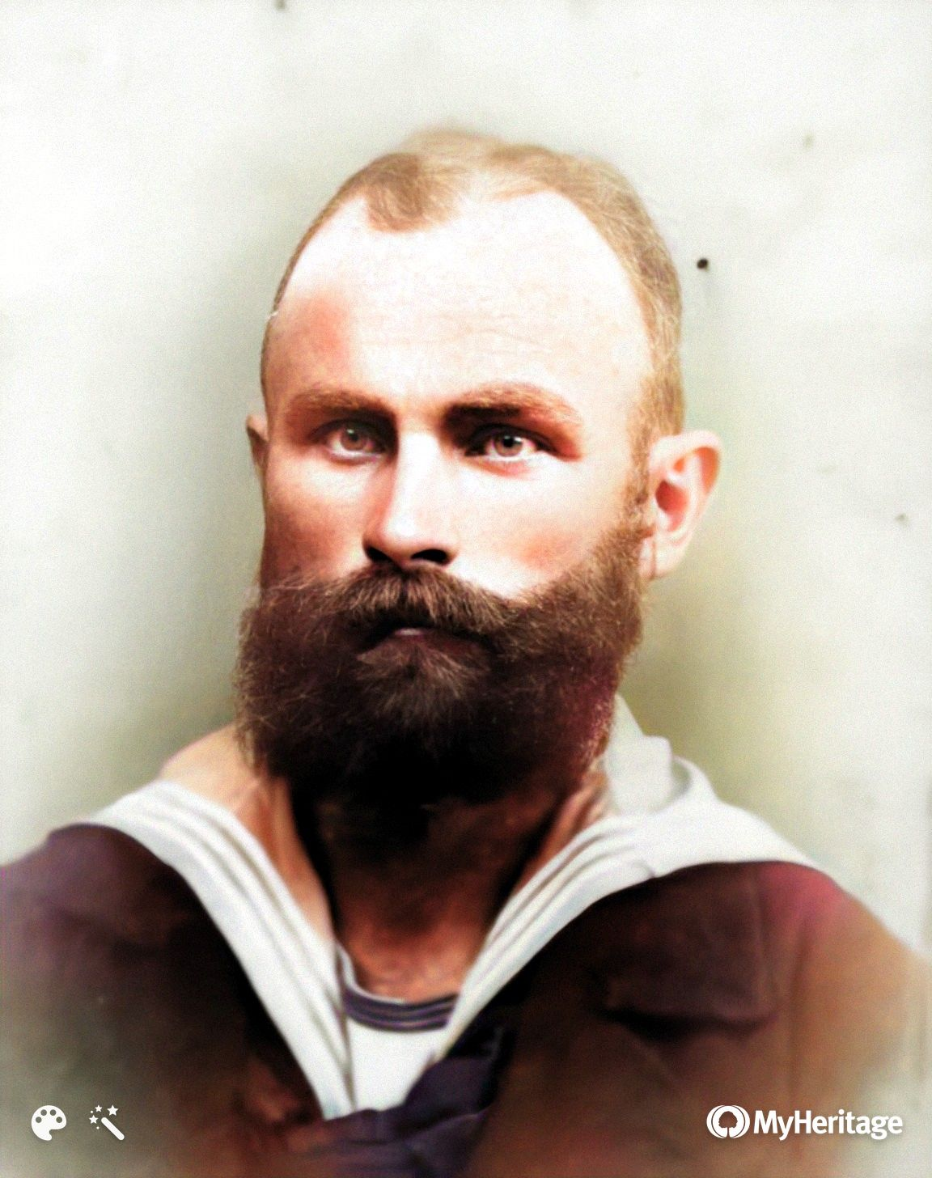
Joined the Navy in 1883 at 16 as a “Schiffsjunge” and retired after 30 years of service shortly before the outbreak of WWI with a rank of “Oberdeckoffizier”
He was re-enlisted of the outbreak of the war and worked in the Navy offices in Wilhelmshaven on the North Sea, which served as the Navy's principal naval base, retiring after the war as “Deckoffizier Leutnant”, a new rank created in 1916.
Obermatrose
Bootsmaschinist
Notes:
Prussia – militaristic, new navy

Slide 21
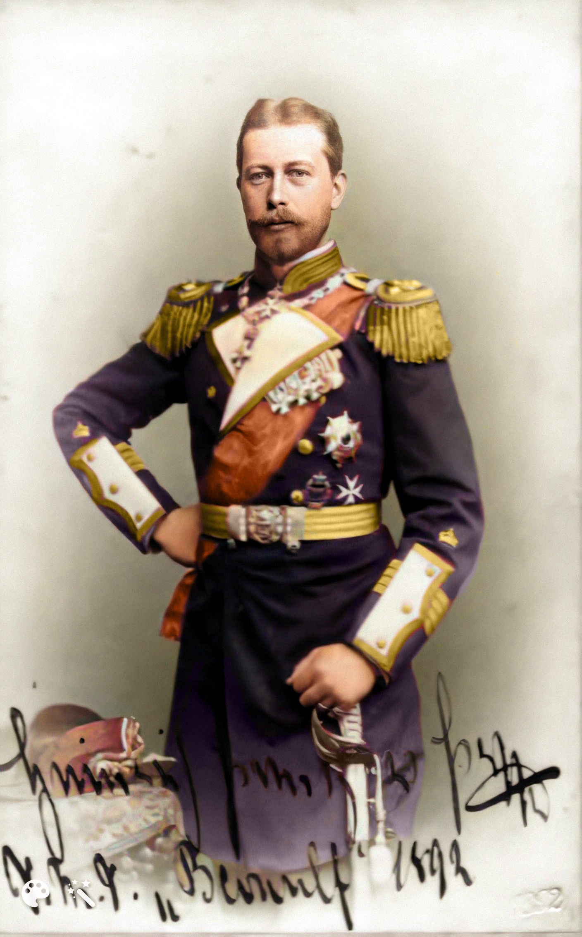
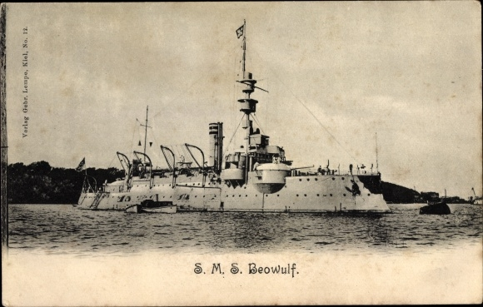
S.M.S. Beowulf
Küstenpanzerschiff (1892 – 1921)
20 Officers and 250 crew
Albert Wilhelm Heinrich von Preußen was a younger brother of Wilhelm II., Grand Admiral and “Generalinspekteur der Kaiserlichen Marine”.

Slide 22
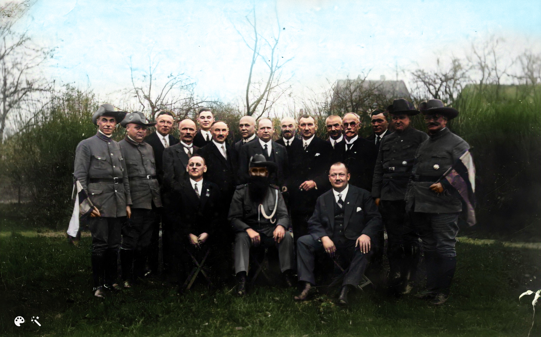
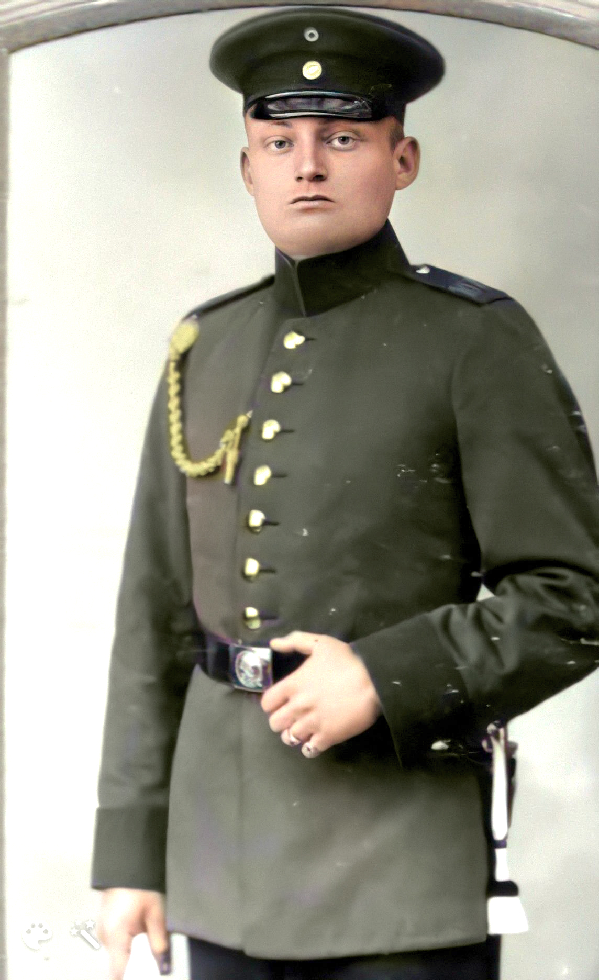
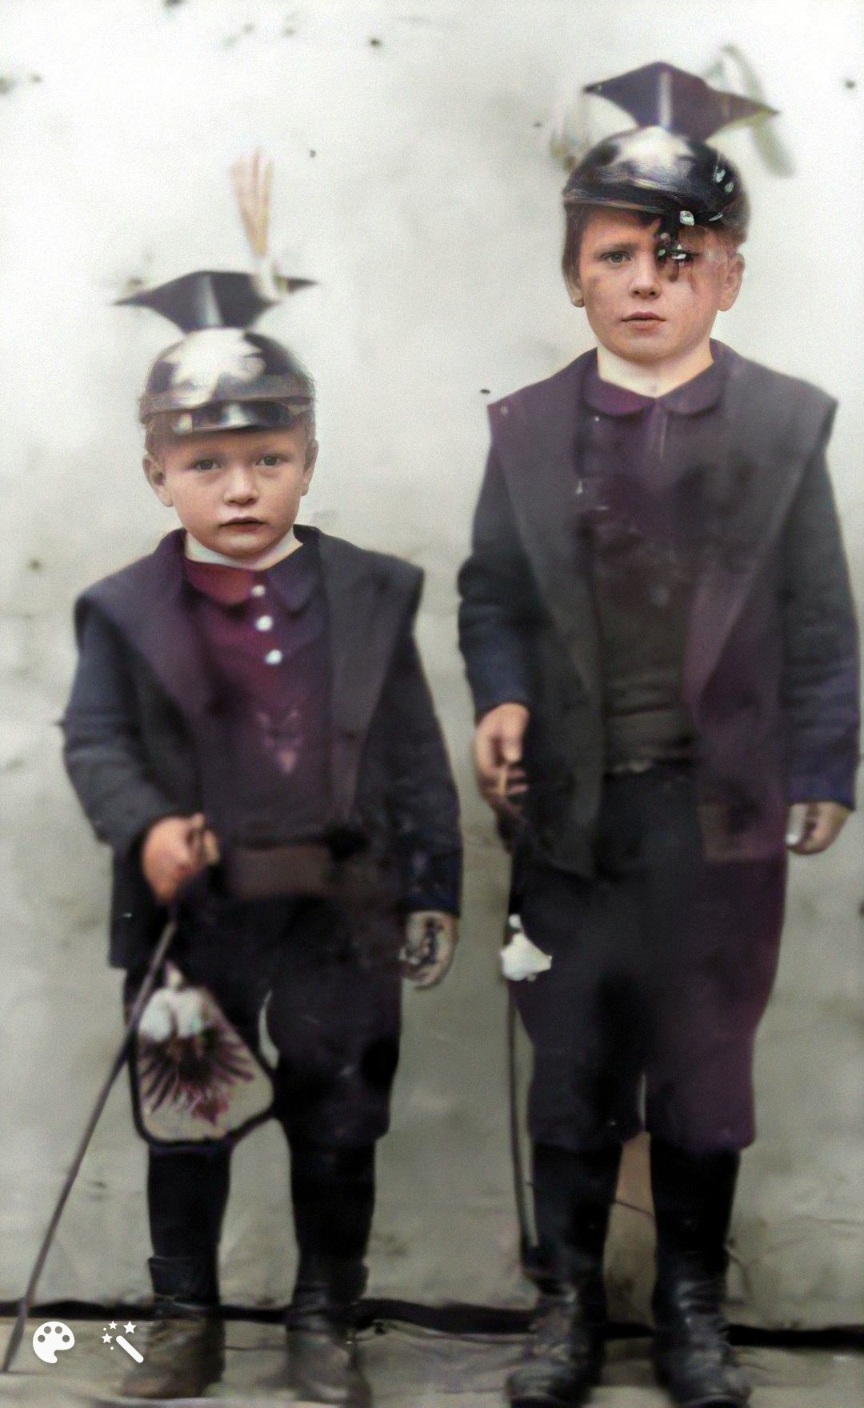
Social Background

Slide 23
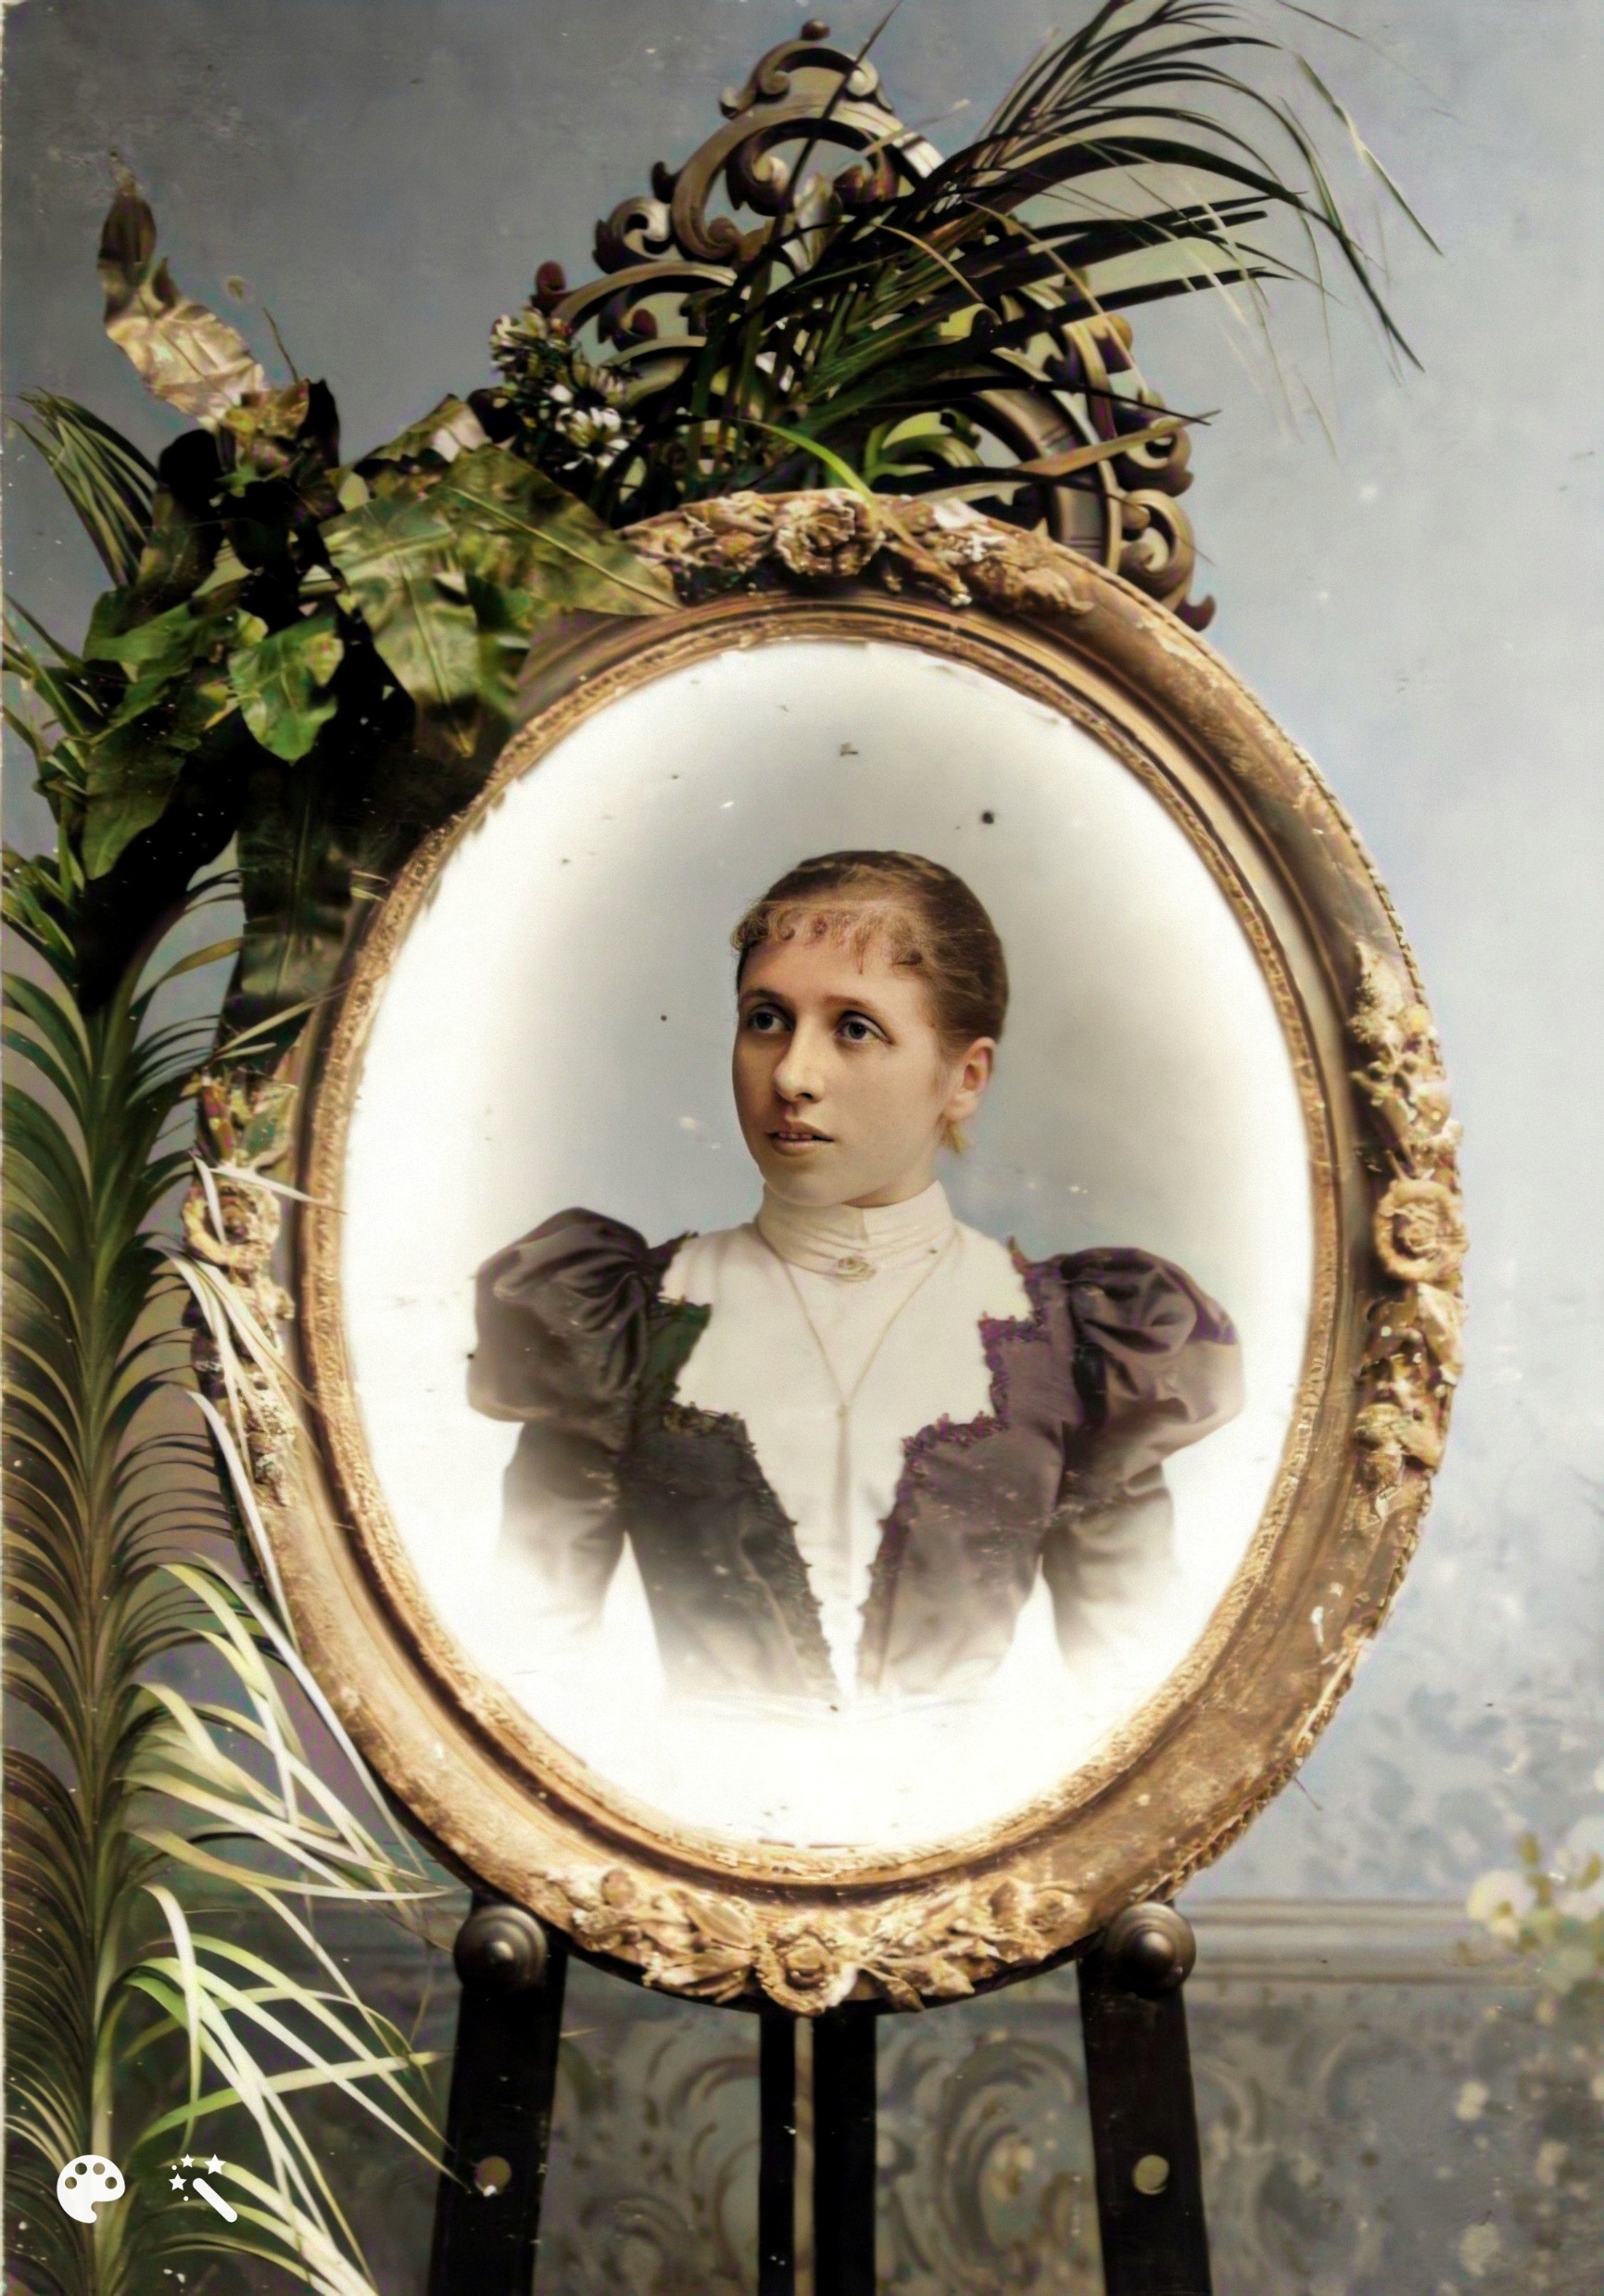
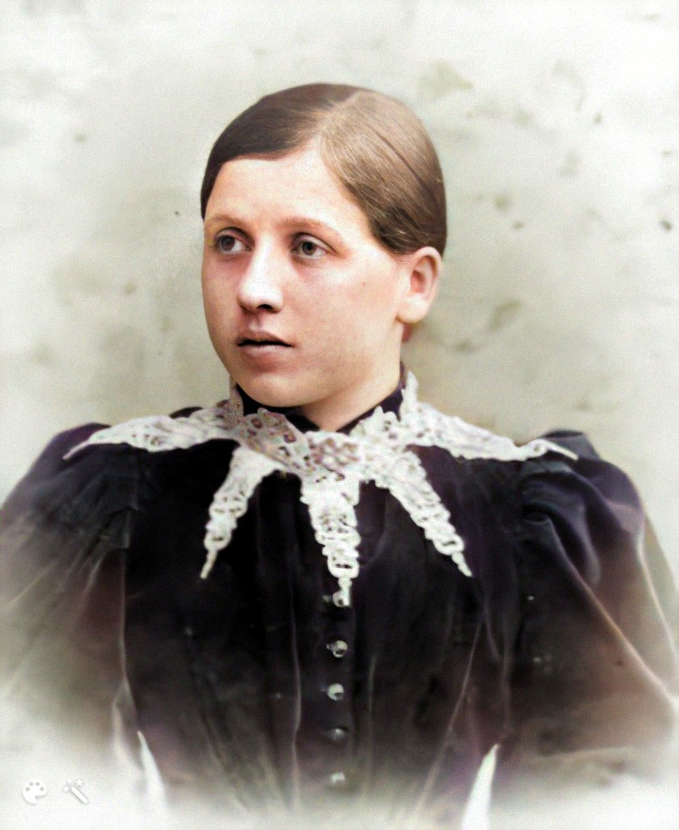
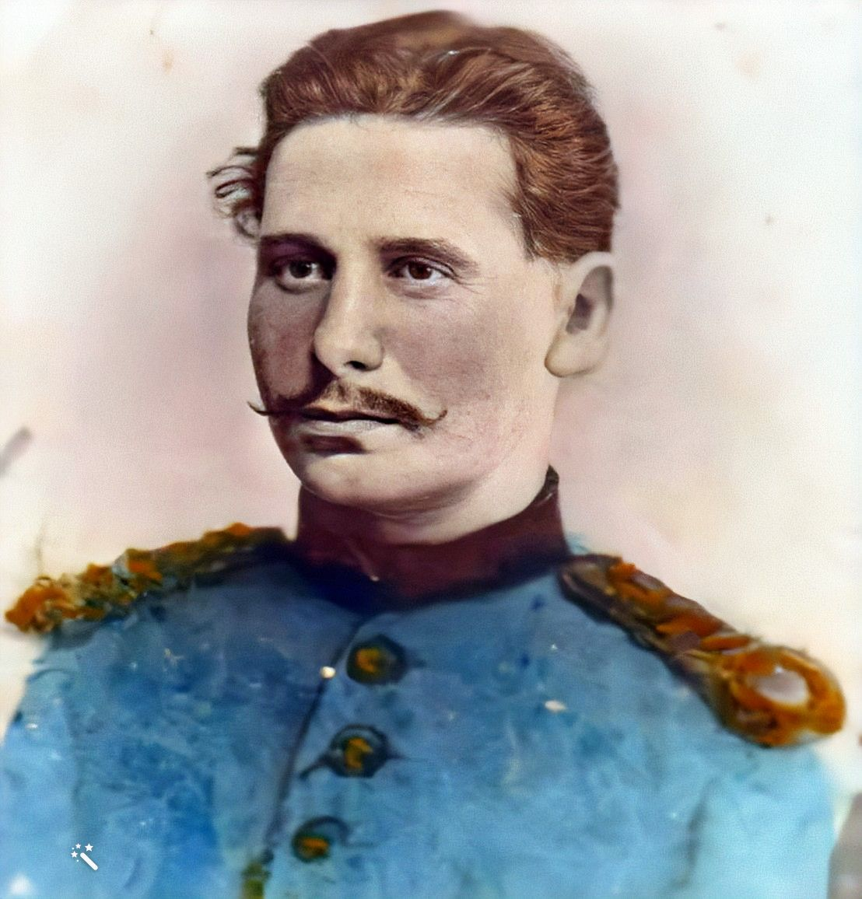
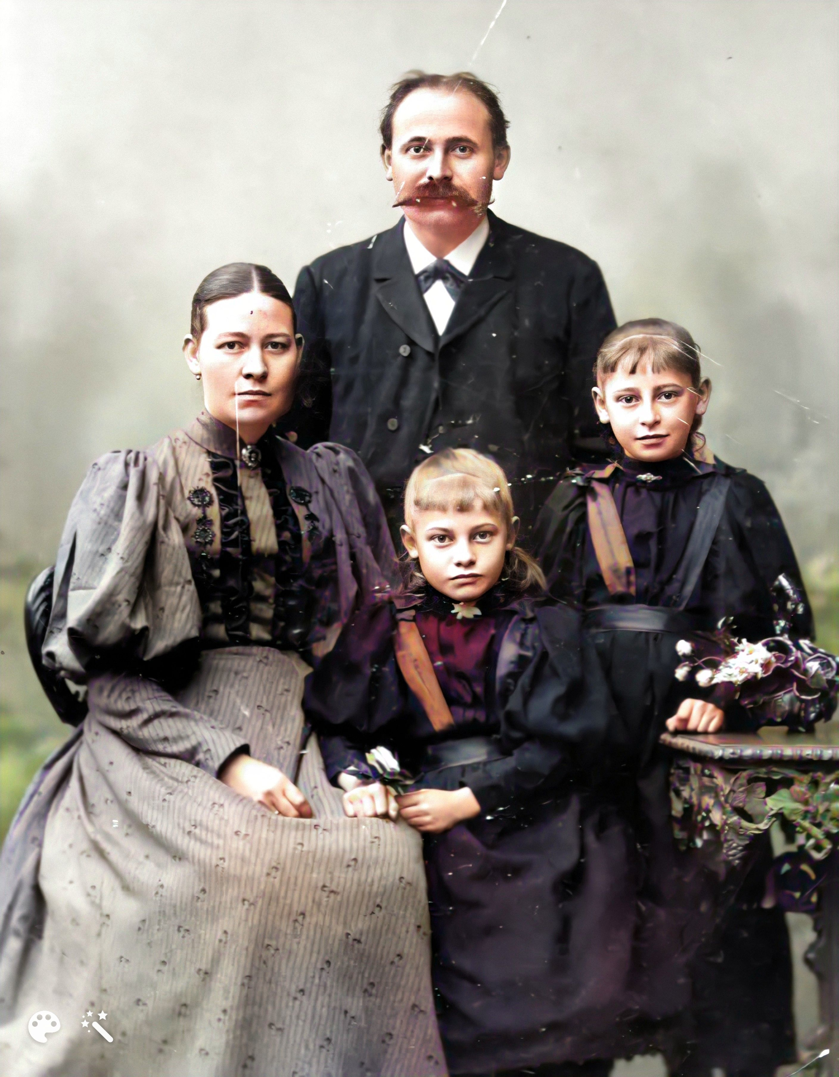
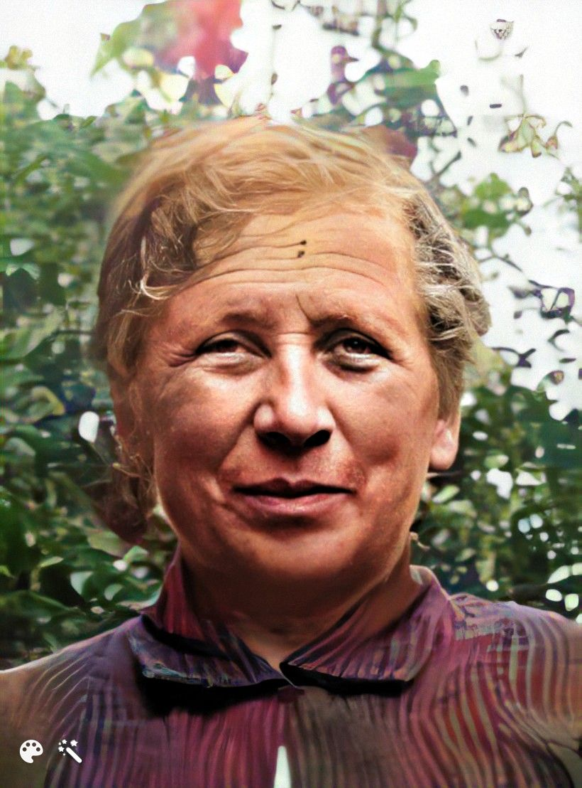
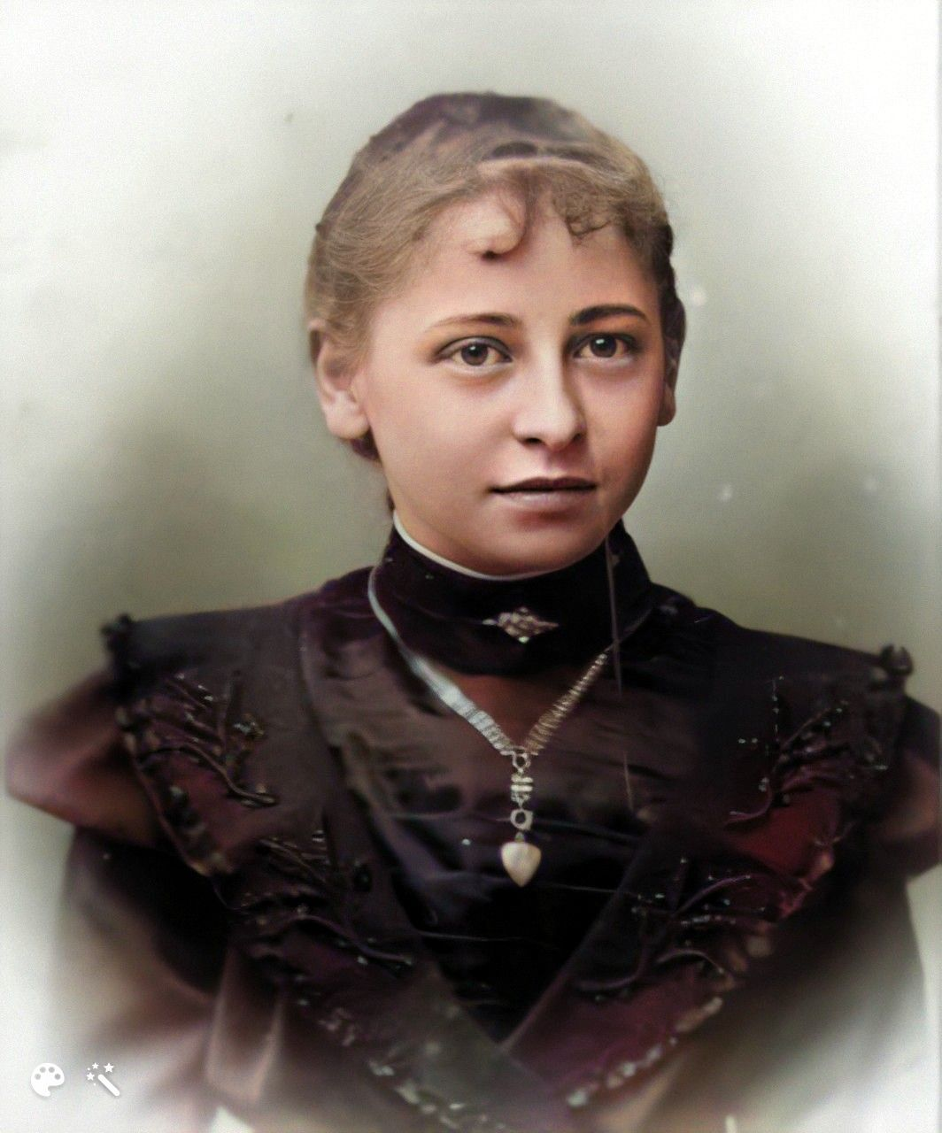
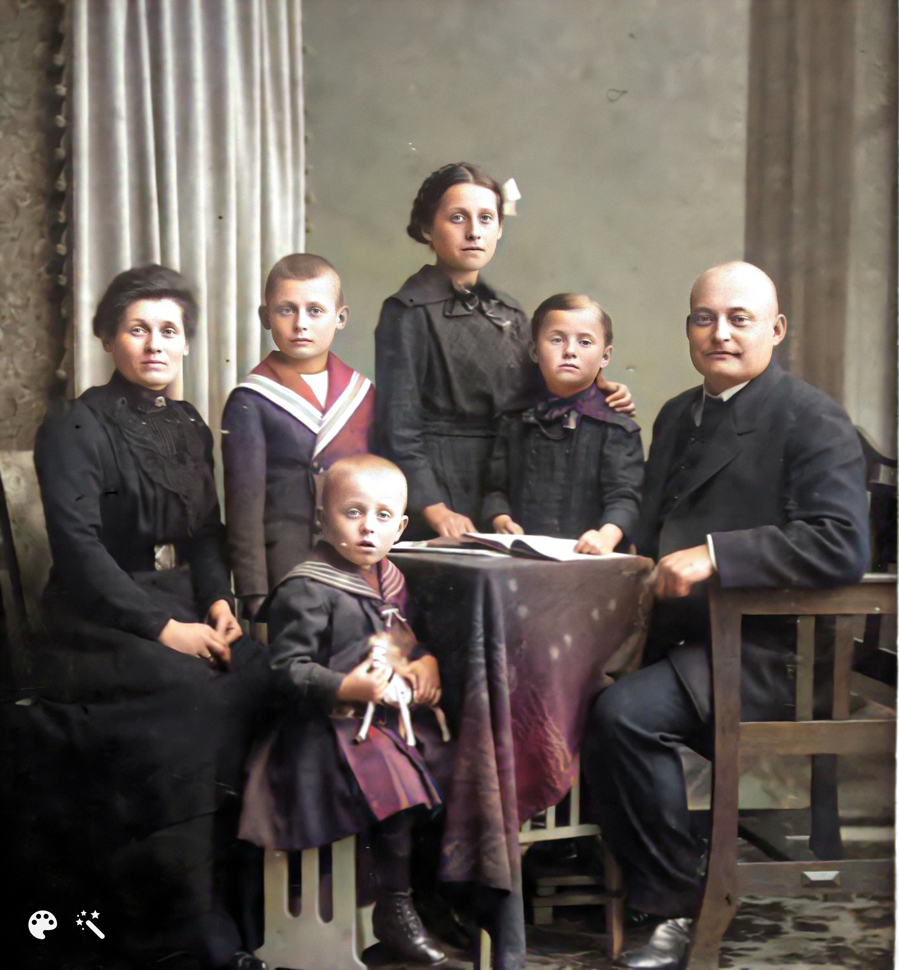
Johanna Margarethe Kadenbach
* 1874 – Leipzig/ Germany ✝ 1944 - Varel/Germany

Slide 24
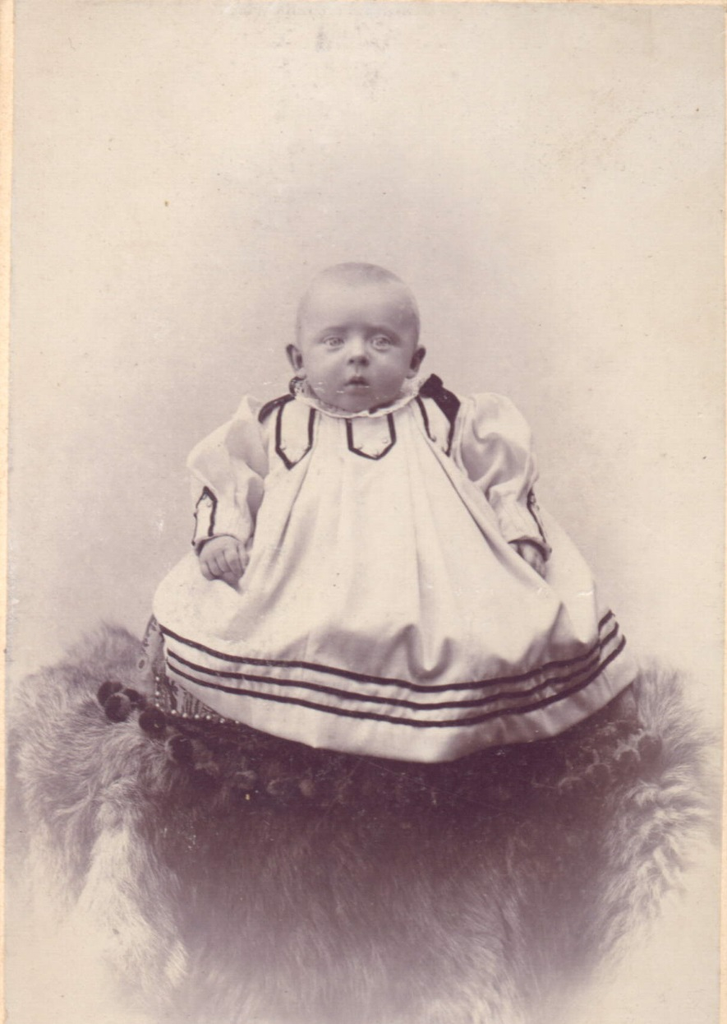
My grandfather
Friedrich Johann Schwarz
* 1902 - Wilhelmshaven
✝ 1987 - Bad Bentheim

Slide 25
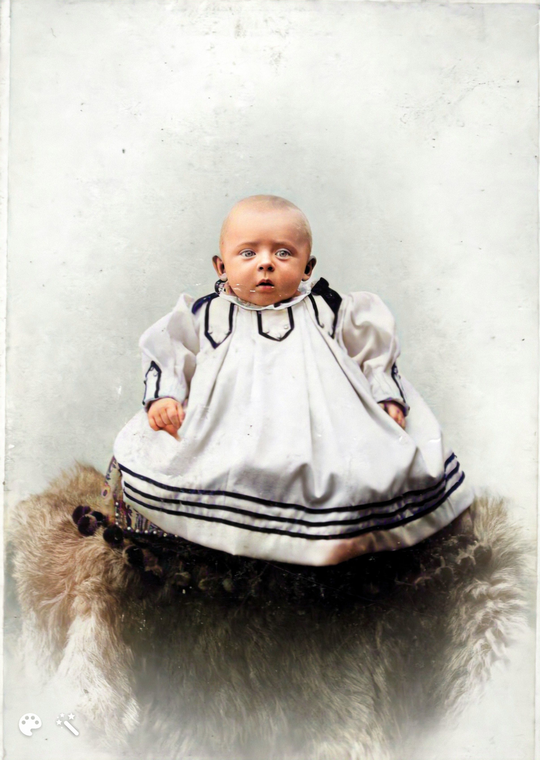
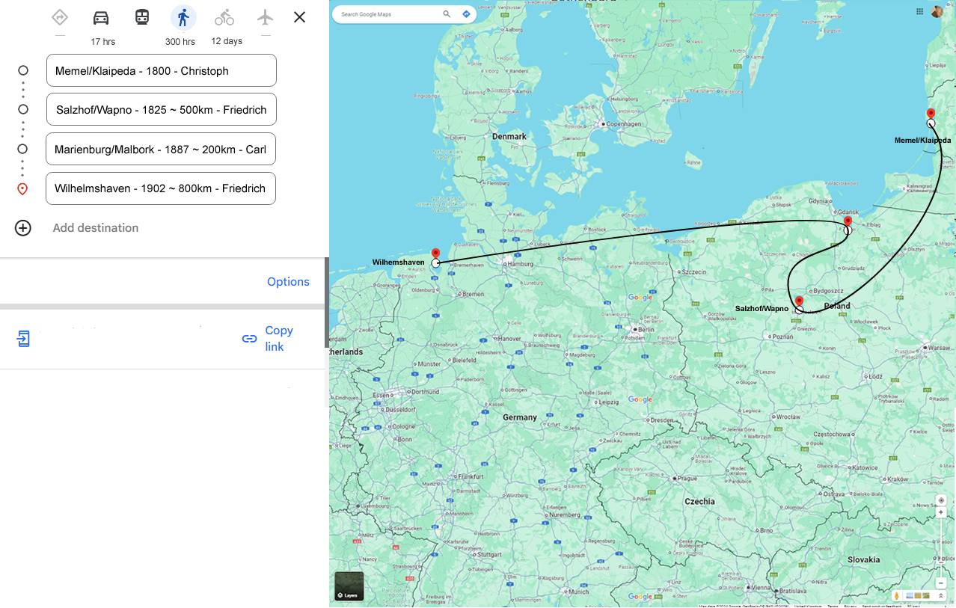
My grandfather
Friedrich Johann Schwarz
* 1902 - Wilhelmshaven
✝ 1987 - Bad Bentheim

Slide 26
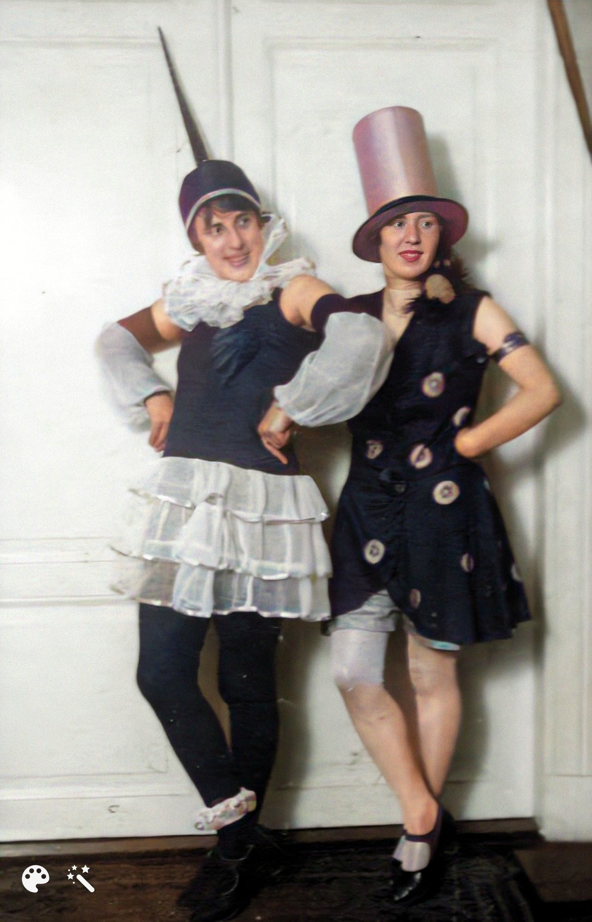
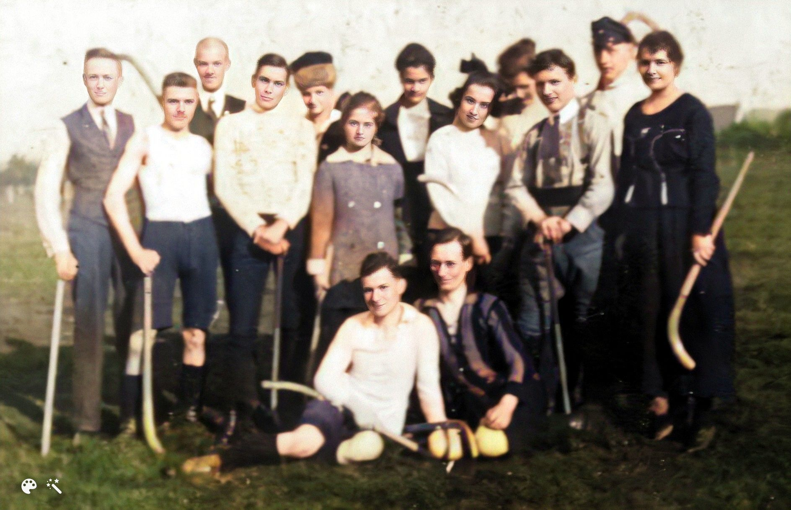
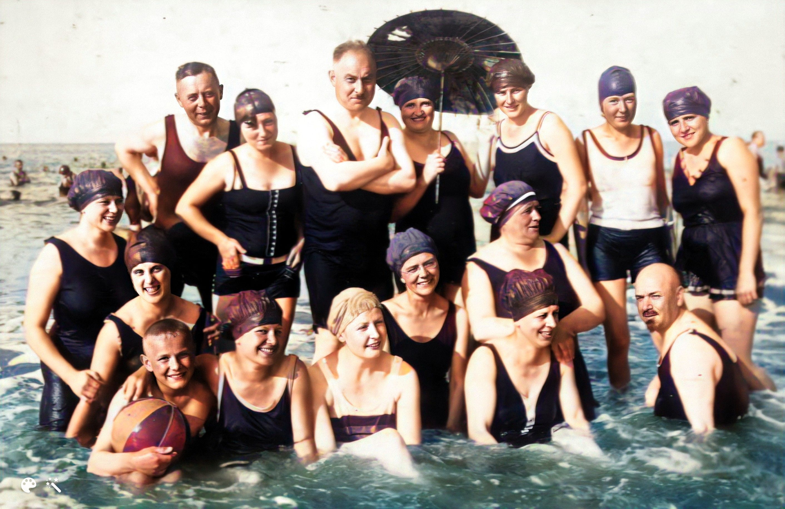
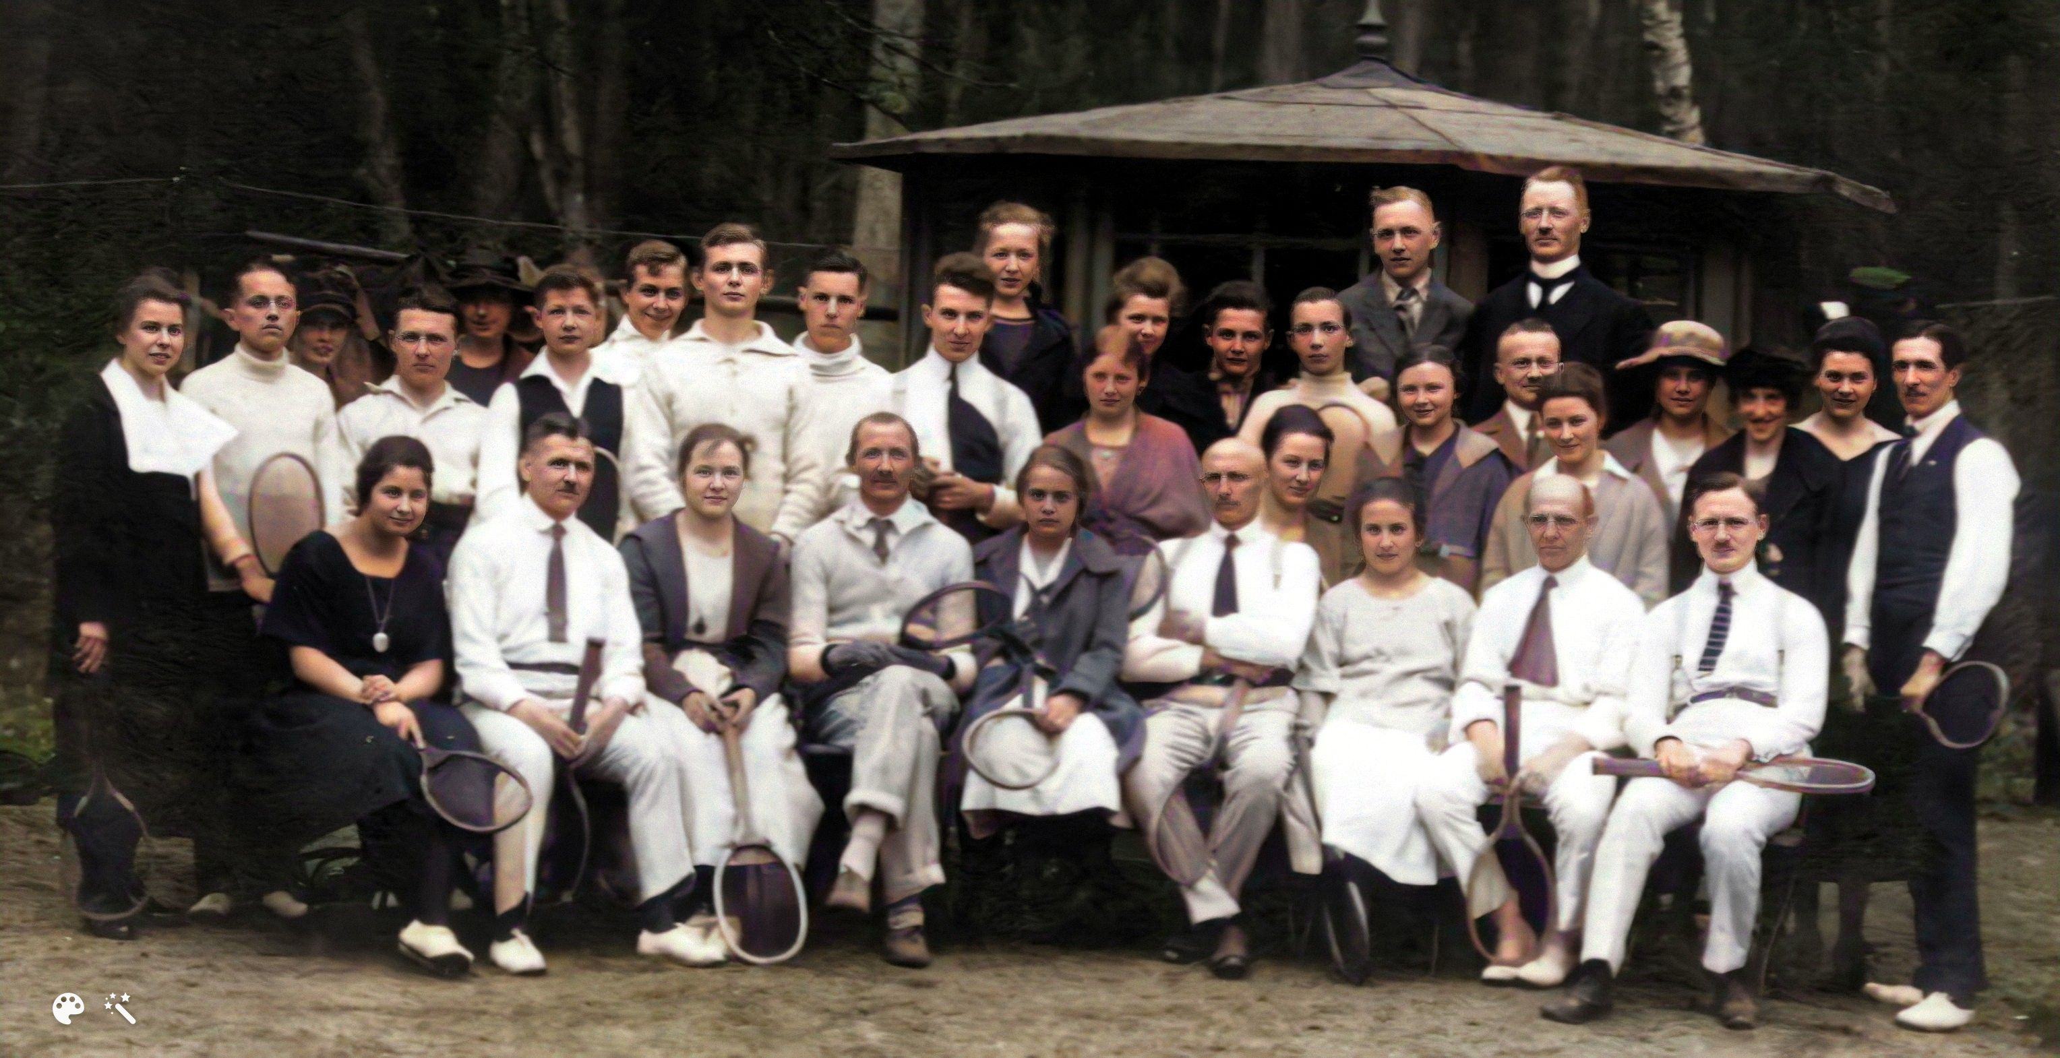
Social Background

Slide 27
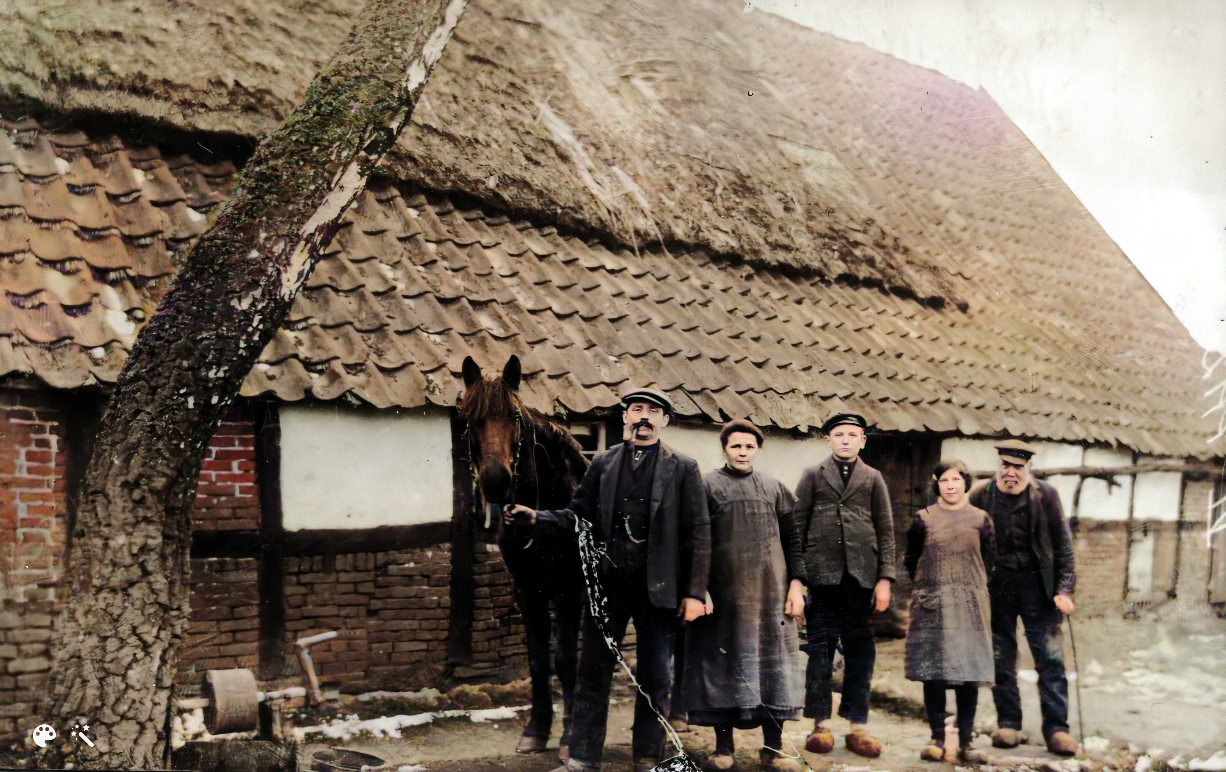
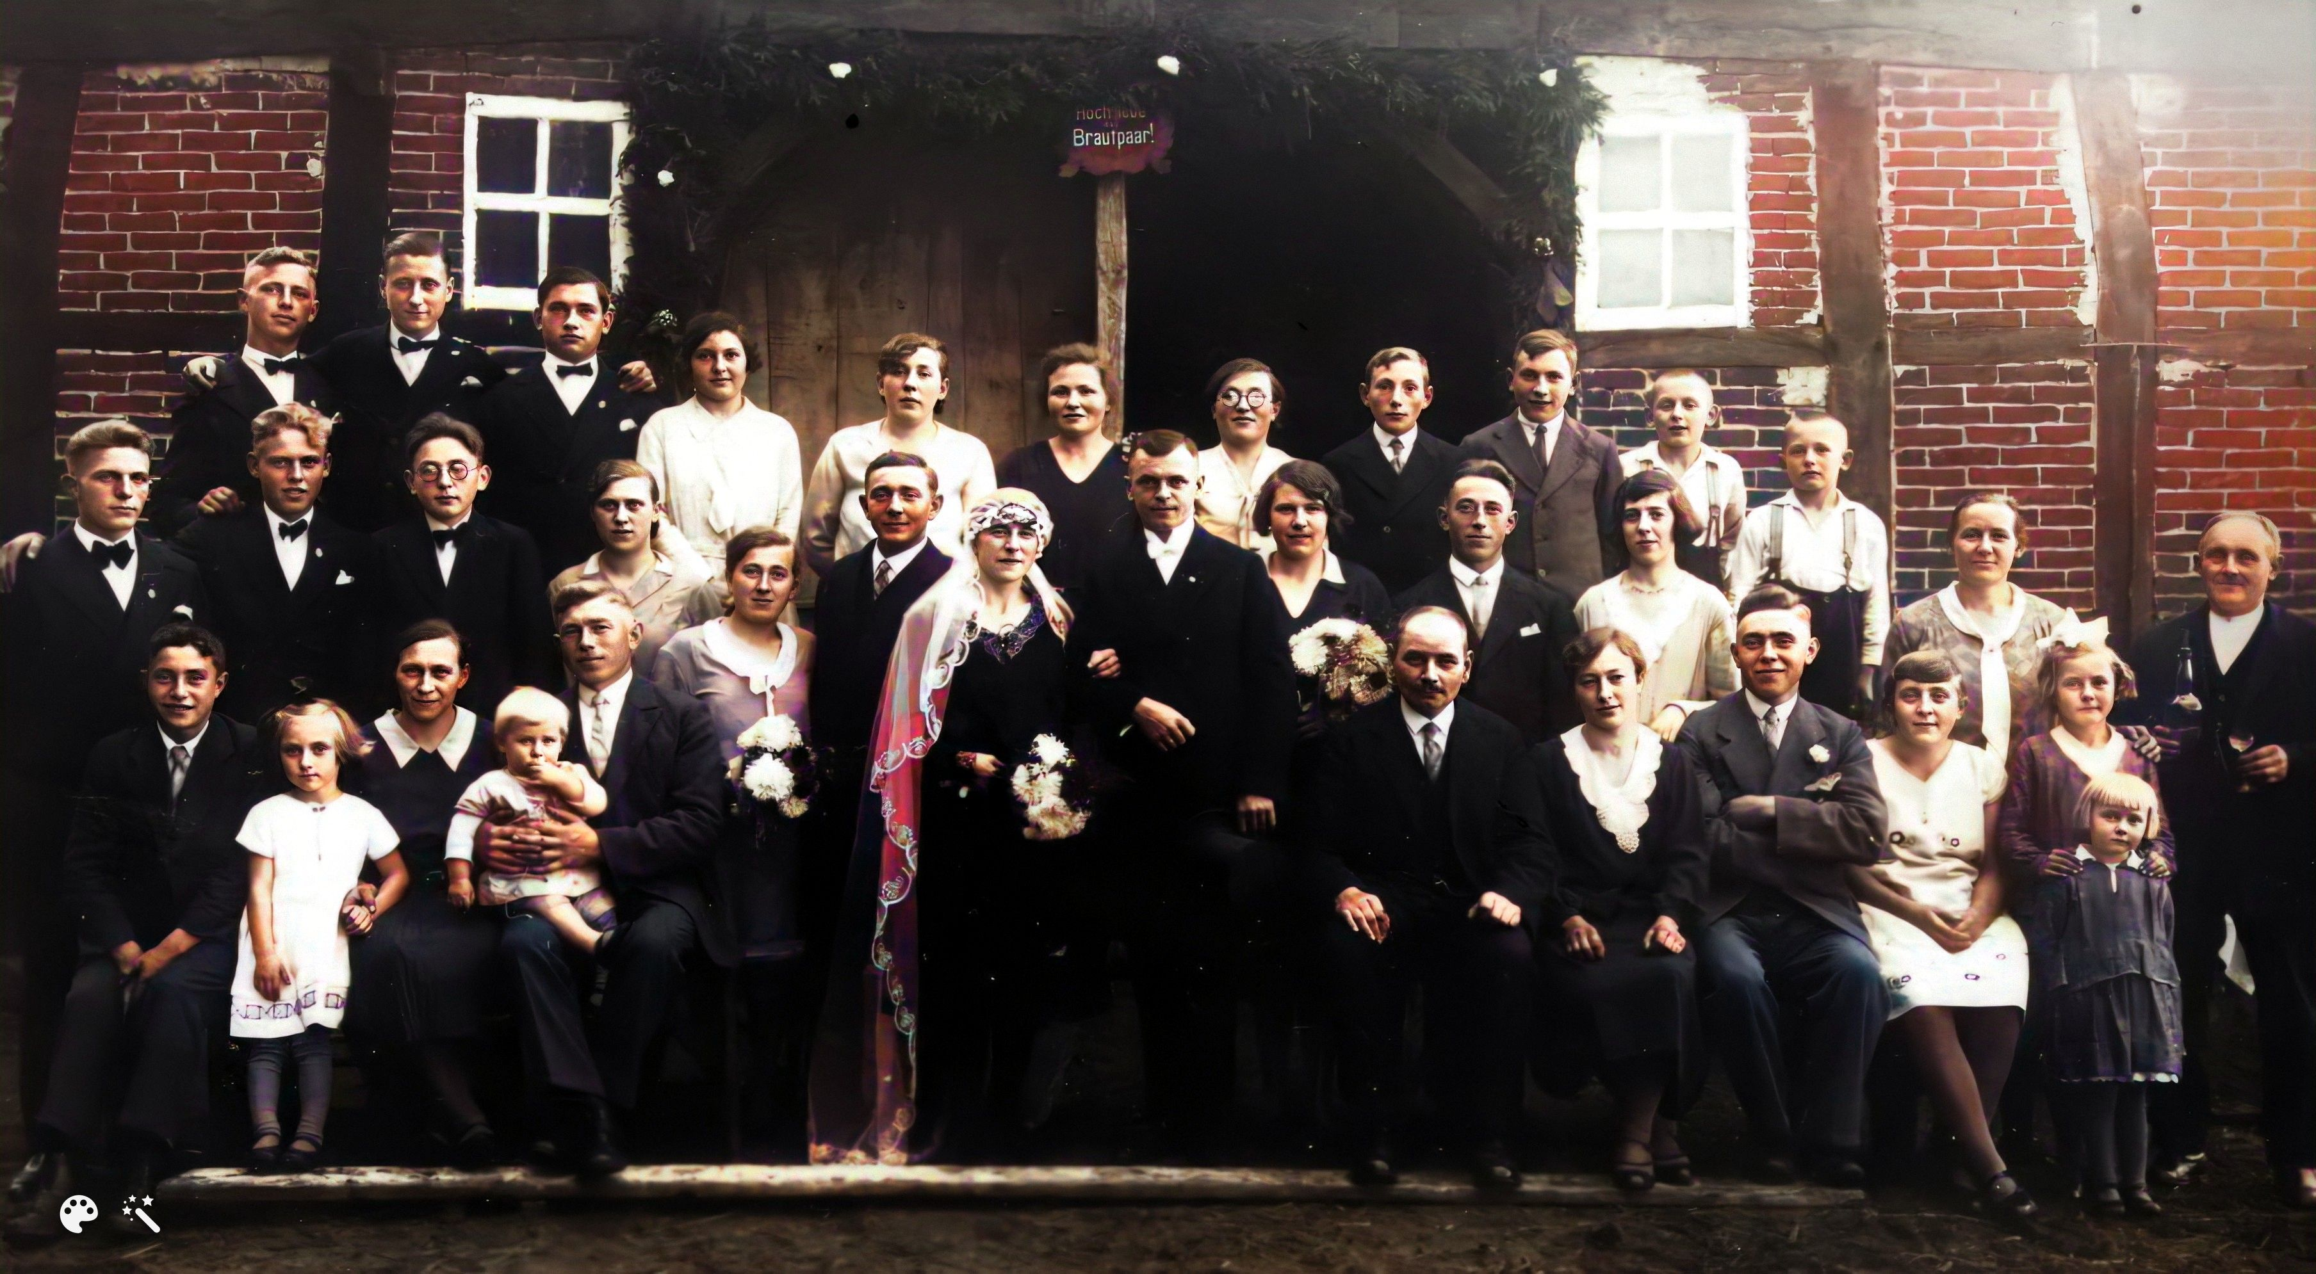
My Grandmother
Anna Agnes Hilling
* 1910 – Lingen
✝ 2002 - Piding

Slide 28
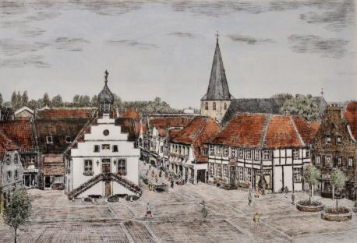



My Grandmother
1900 – Lingen ~ 7,000
inhabitants

Slide 29




Youth
“For Papa”
Grenadier FJS
A grenadier; derived
from the word grenade,
was originally a
specialist soldier
who threw hand
grenades in battle.
“1st of May- 1919 waiting for the Spartakist uprising, but it did not happen”

Slide 30




Student Life Elektotechnik / Electrical Engineering

Slide 31


Student Life
Academic fencing (German: akademisches Fechten) or Mensur is the traditional kind of fencing practised by some student corporations (Studentenverbindungen).
It is a traditional, strictly regulated sabre fight. Opponents fence at arm's length and stand more or less in one place, while attempting to hit the unprotected areas of their opponent's face and head. Flinching or dodging is not allowed, the goal being less to avoid injury than to endure it stoically to prove one's courage.
The scar resulting from a hit is called a "smite" (German: Schmiss), and was seen as a badge of honour, especially in the second half of the 19th century and the first half of the 20th.

Slide 32
Student Life
Academic fencing (German: akademisches Fechten) or Mensur is the traditional kind of fencing practised by some student corporations (Studentenverbindungen).
It is a traditional, strictly regulated sabre fight. Opponents fence at arm's length and stand more or less in one place, while attempting to hit the unprotected areas of their opponent's face and head. Flinching or dodging is not allowed, the goal being less to avoid injury than to endure it stoically to prove one's courage.
The scar resulting from a hit is called a "smite" (German: Schmiss), and was seen as a badge of honour, especially in the second half of the 19th century and the first half of the 20th.
Student corporations who practice academic fencing are predominantly located on the right-wing conservative to right-wing extremist spectrum. There is a tendency toward ethnic nationalism, chauvinism, and traditional values, which are often accompanied by a conservative to right-wing extremist worldview. Women and foreigners are generally not members of fraternities.

Slide 33


Travelling Electrician
Being in and out of work
as a travelling electrician
In the European apprenticeship tradition, the journeyman years (Wanderjahre, also known in German as Wanderschaft, Gesellenwanderung, and colloquially sometimes referred to as Walz, lit. 'waltz') is a time of travel for several years after completing apprenticeship as a craftsman.

Slide 34


What happened ?
Being in and out of work
as a travelling electrician
In the European apprenticeship tradition, the journeyman years (Wanderjahre, also known in German as Wanderschaft, Gesellenwanderung, and colloquially sometimes referred to as Walz, lit. 'waltz') is a time of travel for several years after completing apprenticeship as a craftsman.

Slide 35


NSDAP- Member in 1925
Founded in 1920;
Forbidden in 1923 after failed putsch – 55,000 members;
Resurrected in 1925 – 27,000 members;
1933 formed government – 850,000 members;
1934 – “Märzgefallene” – 3.9 million;
1945 – 8.5 million, about 10% of the population

Slide 36


Next Steps - SA Truppführer

Slide 37



Slide 38


Ortsgruppenpropagandaleiter / Local chief of Propaganda

Slide 39


Ortsgruppenpropagandaleiter / Local chief of Propaganda
Gau: ~ 22 Kreise (2.5 million people)
Kreis: ~ 10 Ortsgruppen (110,000 people)
Ortsgruppe: 8 Zellen (5,440 - 10,880 people)
Zelle: 4 – 8 Blocks (680 – 1,360 people)
Block: about 40 – 60 households with about 170 people

Slide 40

Elektroinstallateur Meisterbrief / Electrician Master Craftsman's diploma 19 January 1928
A "Meisterbrief" is a German qualification that signifies a Master Craftsman's diploma, representing the highest level of vocational training in a specific trade.
It's a state-approved degree earned after extensive training in both theoretical and practical aspects of a craft, as well as business and legal knowledge.
Holding a Meisterbrief allows individuals to train apprentices and often equates to a bachelor's degree in terms of recognition.

Slide 41






Reichsarbeitsdienst Reich Labour Service
The Reich Labour Service (Reichsarbeitsdienst; RAD) was a major paramilitary organization an agency to help mitigate the effects of unemployment on the German economy, militarise the workforce and indoctrinate it with Nazi ideology. It was the official state labour service. From June 1935 onward, men aged between 18 and 25 served six months before their military service.

Slide 42



Officer ? Oberfeldmeister - 1935

Slide 43

Wedding - 1935
Met in 1929, during the Great Depression, a severe global economic downturn.
He was an electrician, but largely unemployed, she was working as a seamstress and came from a little farm.
Got engaged and married six weeks later in 1935:
„Nee, wenn schon, denn schon, sech´ he. Du kannst arbeiten, du kannst kochen, du kannst alles. Mehr bruck we nich, sech´ he.“

Slide 44



What happened ? (2)
1936 – studies Flight Engineering

Slide 45

What happened ? (2)
Ariernachweis: a document which certified that a person was a member of the presumed Aryan race.
Three generations required for all state employees and officials in the public sector; seven generations for higher party posts, ministries, SS.

Slide 46






Fliegerhauptingenieur = Officer !

Slide 47




End of war = end of dreams ?

Slide 48

Aftermath Denazification: 1. Hauptschuldige / Main perpetrators: Leading National Socialist 2. Belastete / Incriminated: Activists, militarists, beneficiaries, e.g., members and officials of the NSDAP and its organizations who had held higher positions. 3. Minderbelastete / Less incriminated: e.g., ordinary members of the NSDAP and its organizations without specific functions. 4. Mitläufer / Followers: People who did not always actively participate in the system, but who overall made up the large silent mass of supporters of National Socialism. 5. Entlastete / Exonerated: Persons who were able to prove before a tribunal that they were not guilty. For groups 1 to 3, punishment could include the death penalty, imprisonment, confiscation of property, dismissal from work, loss of pensions, salary reductions, work restrictions, and loss of civil rights. For followers, fines were imposed. The cases of those incriminated in groups I and II were heard orally and publicly, while those of the others were dealt with in writing. Statistical results of denazification in Bavaria: By December 31, 1949, questionnaires from 6,780,188 people had been processed in Bavaria (total population 7.791.000) 290,139 people (15.5%) were classified into one of five categories: 1. 0.27% were main perpetrators, 2. 3.85% were incriminated, 3. 18.31% were less incriminated, and 4. 74.52% were followers. 5. 3.05% of them were classified as exonerated Though cases were brought against 140,000 individuals, only around 15,000 were convicted and of those only 567 individuals were sentenced to death or life imprisonment for their actions. The others received prison sentences of less than 3 years. By the mid-1950s, most of these prisoners were released due to amnesties and political pressure.

Slide 49


Grandfather or Monster ?

